Slide 1
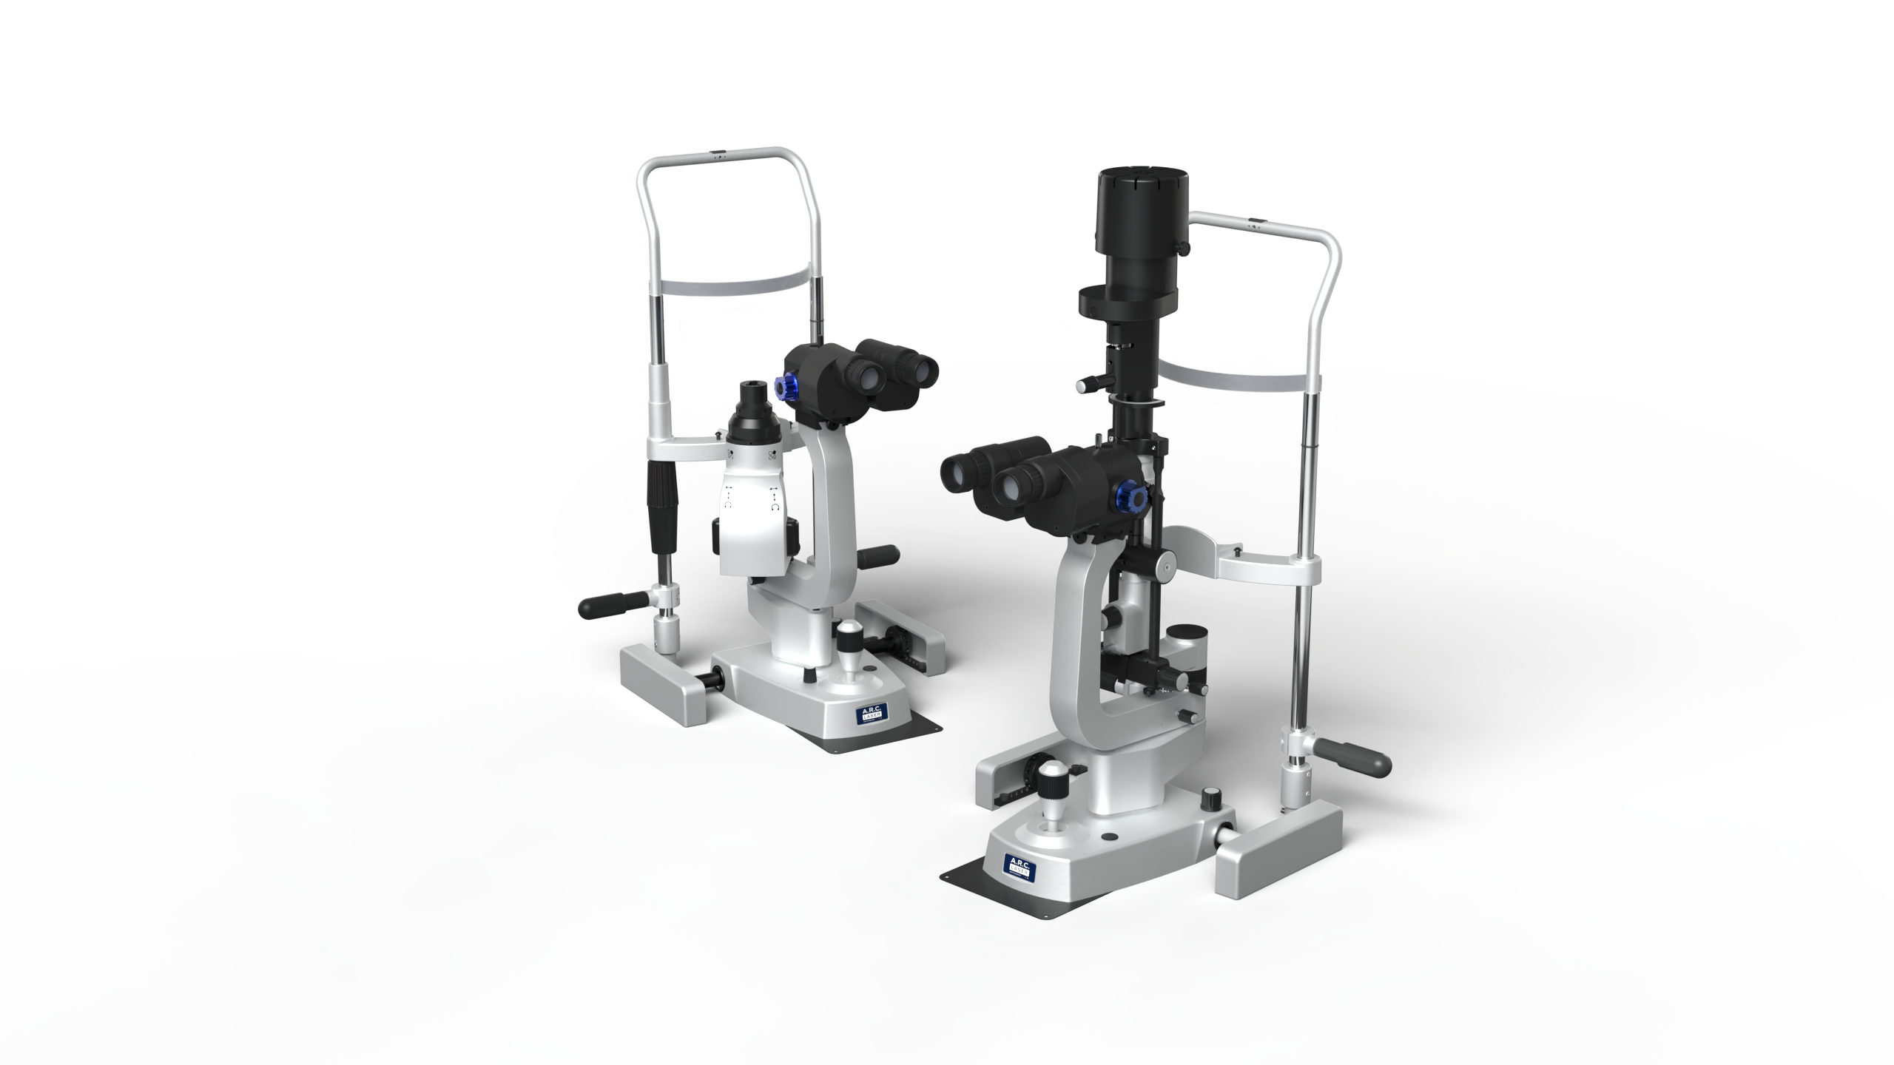
PCL 5 ^{Z & SH}
Brilliant optics and ultra visual view – Made @ A.R.C. Laser
Elegance – Precision - TrueColor

Slide 2
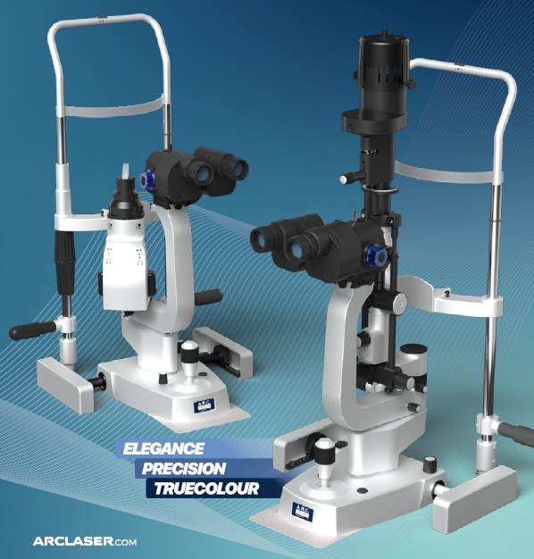
PCL 5 – A.R.C. Laser SLIT LAMPS
PCL 5 Z & PCL 5 SH
High level of user comfort
Great depth of field
Cable-free design
LED light module for great light output
Unique TrueColor filters
Brilliant stereoscopic optic
Inter-changeable microscope parallel or convergent
High colour fidelity
Blue, green and grey filter + UV are standard
Detailed images
5-stage magnification changer as standard

Slide 3
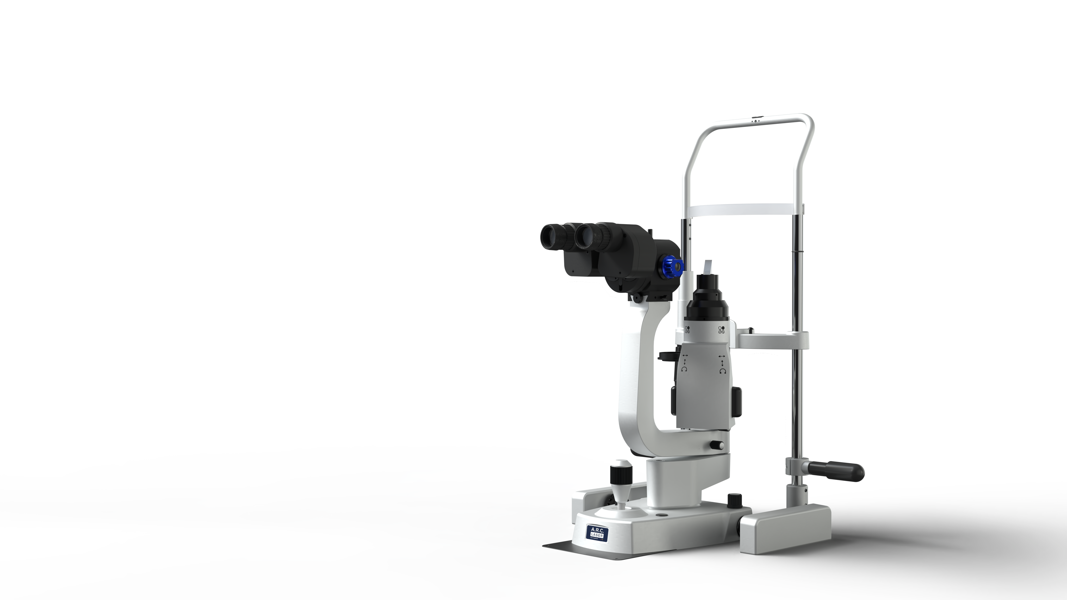
OUTSTANDING IMAGE QUALITY AND DETAILED VISUALISATION IN THE ANTERIOR SEGMENT
PCL 5 Z
Slit width (continuously adjustable): 0 - 8 mm
Slit height (continuously adjustable): 0.5 - 8 mm
Illumination fields: 0.2; 1; 2; 3; 4; 6; 8 mm
Slit rotation: ±90°
PCL 5 Z with parallel microscope as standard

Slide 4
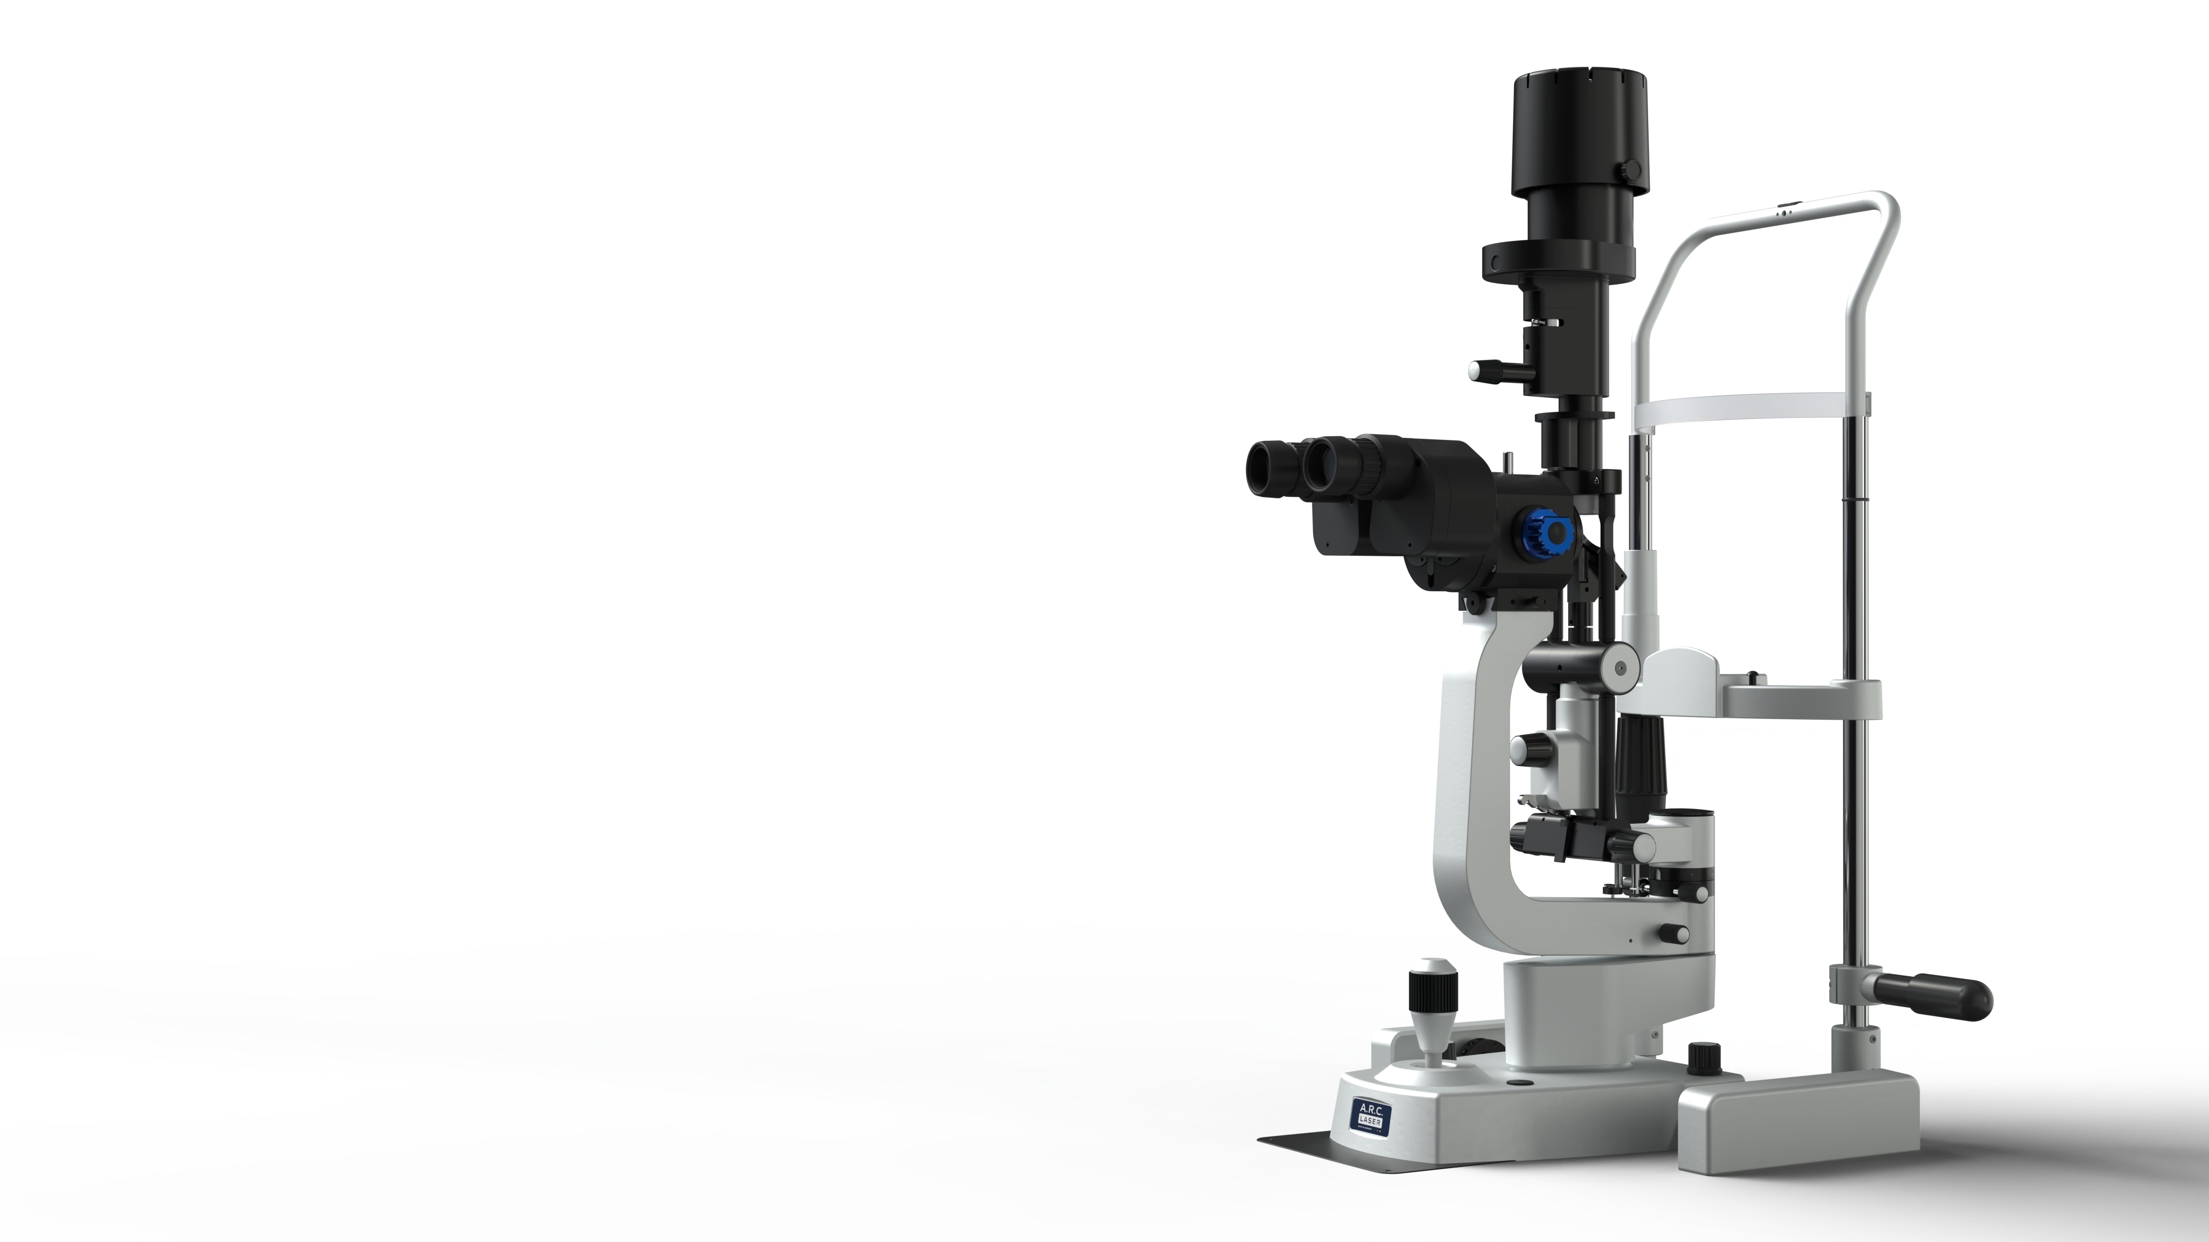
OUTSTANDING IMAGE QUALITY AND DETAILED VISUALISATION IN THE POSTERIOR SEGMENT
PCL 5 SH
Slit width (continuously adjustable): 0 - 16 mm
Slit height (continuously adjustable): 1 - 16 mm
Illumination fields: 1 mm
Slit rotation: ±90°
PCL 5 SH with convergent microscope as standard

Slide 5
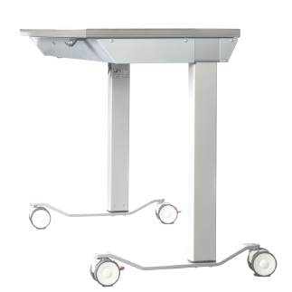
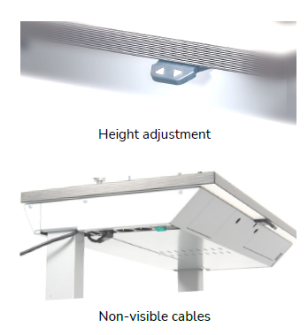
A.R.C. LASER SLIT LAMP TABLES ARE THE IDEAL BASIS FOR OUR PREMIUM SPLAT LAMPS
Slit lamp tables
Space-saving
Clean design without annoying cables
Wheelchair accessible
thanks to the sturdy two-column design
Electric height adjustment:
table height 72 - 95 cm
Optional castor version

Slide 6
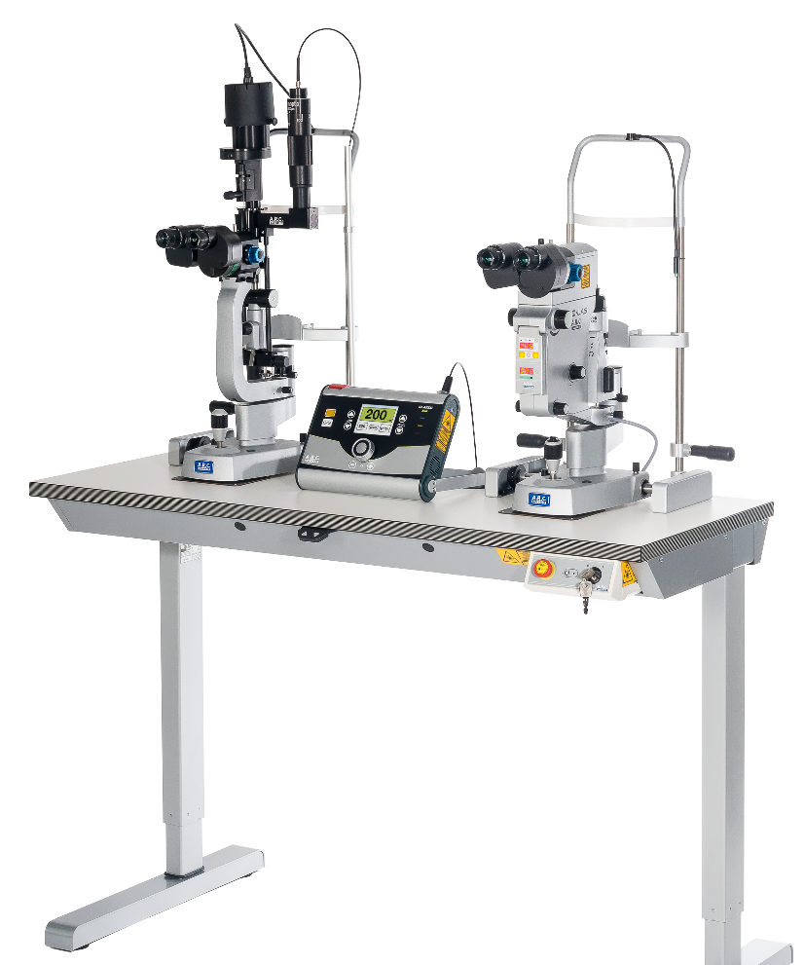
SLIT LAMP
PCL 5 - VARIO
VARIO combination
Cito 532 with
Classic 514
COBRA with
Classic 514
Not combined in one slit lamp as
PCL 5 Z is designed for best application in anterior section of the eye
PCL 5 SH is designed for best visualization of retina in central field and in periphery

Slide 7
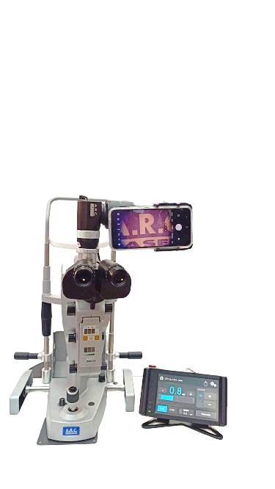
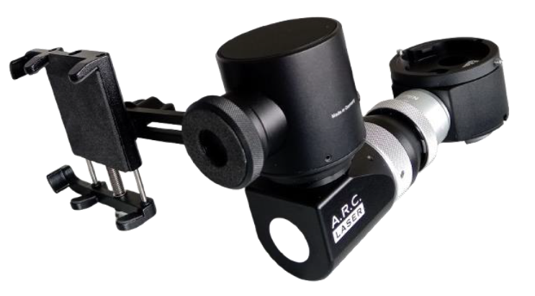
CITO 532
Phone imaging port for PCL 5
Phone-Imaging-Port for:
Photography
Filming
Live observing
A.R.C. Laser REF: ZU01108
Description: Beamsplitter with mobile phone adaption
Upgrade your mobile phone for documentation and training purpose!
High-quality beam splitter:
Picture rotation function
High-quality optics
For mobile phones up to 6.8” display size
Portrait and landscape format

Slide 8
