Slide 1
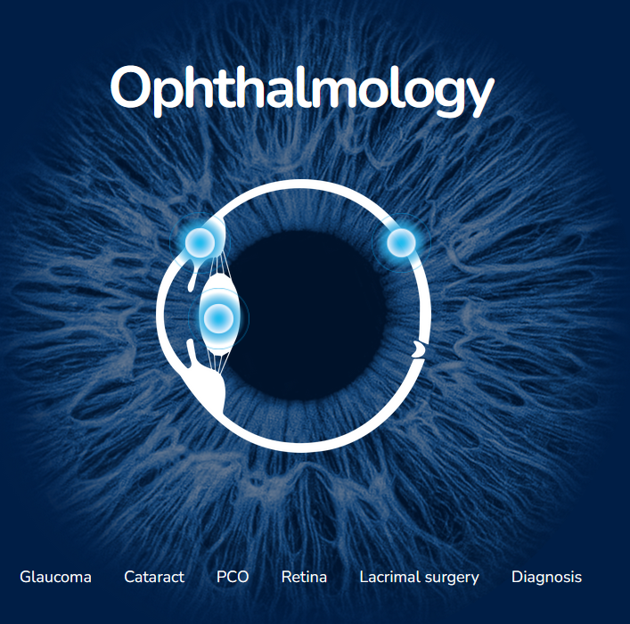
LASER PORTFOLIO

Slide 2
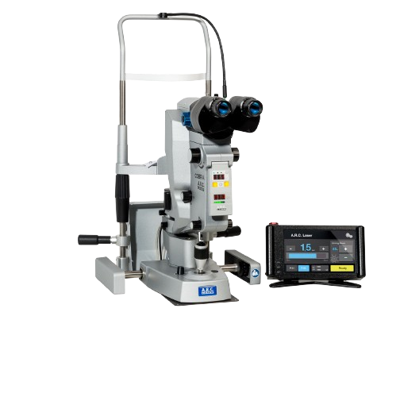
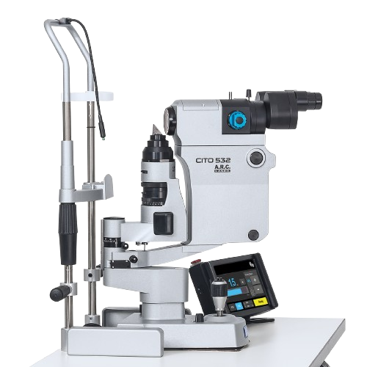
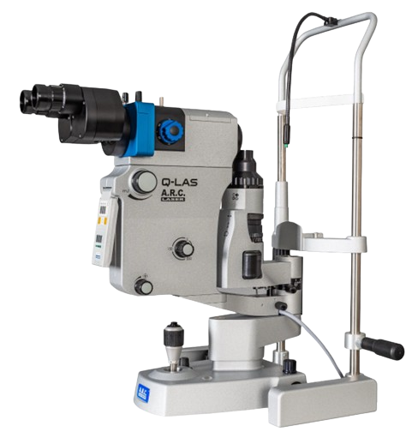
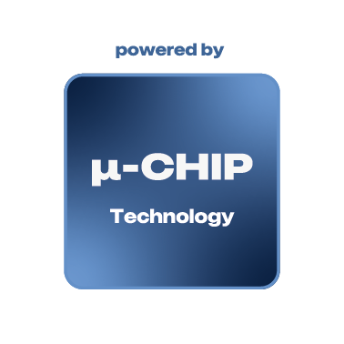
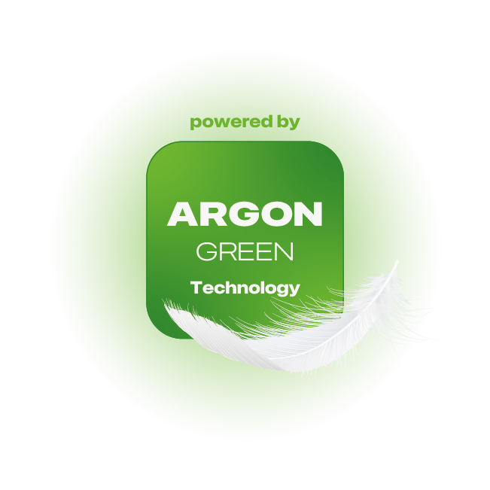
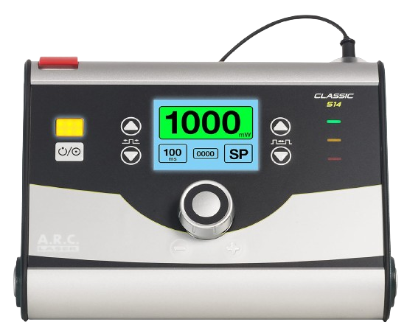
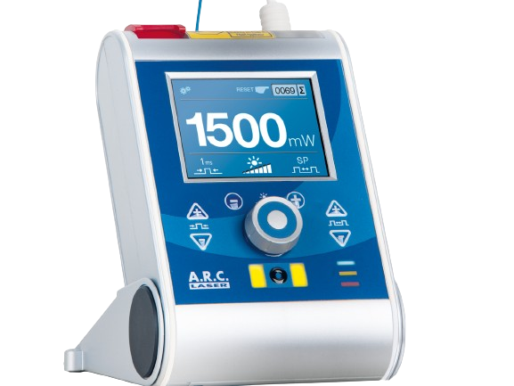
A.R.C. Laser Product Portfolio Ophthalmology
Overview
µ-chip Technology line:
high efficiency – fast repetition
Argon-Green Technology line:
original argon wavelength – soft coagulation

Slide 3
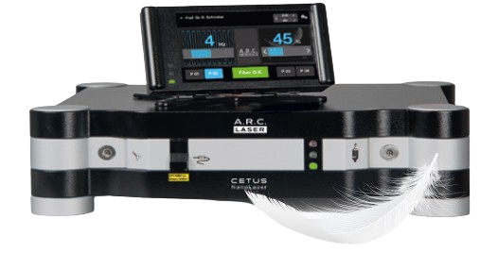
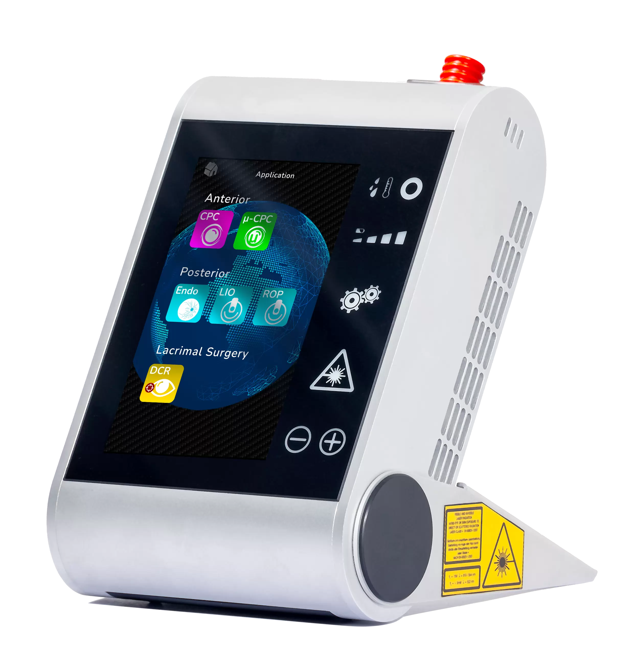

A.R.C. Laser Product Portfolio Ophthalmology
Overview
UniTech line:
Unique – innovative

Slide 4

EFFICIENCY | SPEED | RELIABILITY
Q-LAS D – ND:YAG LASER
NEW!
High efficiency + great pulse-to-pulse stability
Repetition rate up to 4 Hz – independent of burst mode
Head-up display
Prism position control
Dual hand control
Tiltable control panel
Dual-spot aiming beam technology
Posterior focus-shift
Continuous energy adjustment
0,5 – 10 mJ
Triple burst-mode
Pulse and energy counter
CAPSULOTOMY
IRIDOTOMY
Notes:
Platzhalter Folie → Schlagwörter und Informationen überarbeiten

Slide 5

EFFICIENCY | HOMOGENEITY | SPEED
CITO - SLT-LASER
High efficiency + great pulse-to-pulse stability
Quick-repetition: worldwide fastest repetition rate (10 Hz) for shortest treatment time
Homogeneous energy distribution for uniform treatment
Individual storable treatment programs
Continuous energy adjustment
0,2 – 2 mJ
Easy touch control
SLT IN OPEN ANGLE GLAUCOMA

Slide 6
SPACE SAVING | INDEPENDANT | VERSATILE
COBRA - ND:YAG & SLT-LASER COMBINATION
Cobra combines SLT laser CITO 532 and Nd:YAG laser Q-LAS in one slit lamp
High-quality precision optics designed for the anterior segment of the eye
Two independent laser cavities offer a particularly long service life
CAPSULOTOMY (Q-LAS)
IRIDOTOMY (Q-LAS)
SLT (CITO)

Slide 7
ORIGINAL ARGON | GENTLE | 100% COAXIAL
CLASSIC ⁵¹⁴ – RETINAL LASER
Argon-Green Technology: original argon-wavelength 514 nm
Soft and homogenous coagulation thanks to original argon-green technology
100 % coaxial slit illumination thanks to super view coupling
APL mode for retinal therapy with microsecond pulses
continuous power range of 50 mW – 1,3 W
intuitive operating concept
integrated truecolour-filter
RETINAL COAGULATION
RETINA THERAPY
LESS STRESS &
REDUCED PAIN

Slide 8
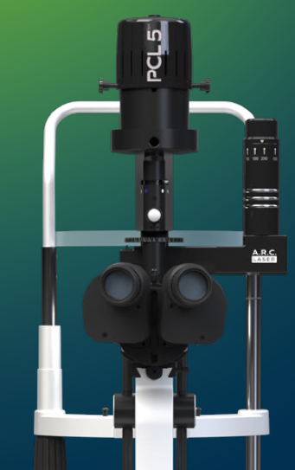
ORIGINAL ARGON | GENTLE | 100% COAXIAL
CLASSIC ⁵¹⁴ – RETINAL LASER
New cover of illumination tower and better plug connection for illumination.
→ Change of assembly unit needed
Zoom optics ‘SuperView’ in black

Slide 9
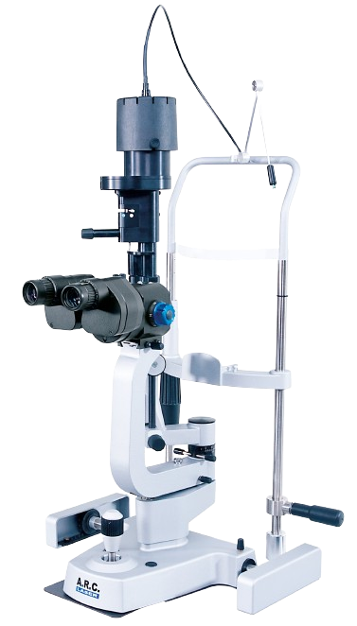
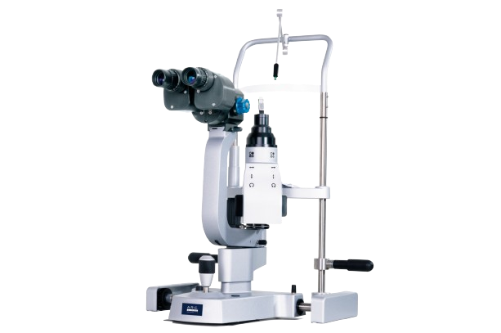
ELEGANT | PRECISION | TRUECOLOUR
PCL 5 Z & PCL 5 SH – A.R.C. SLIT LAMPS
Made by A.R.C. Laser
Brilliant precision optics optimized for the anterior and posterior segment of the eye ensure outstanding image quality and detailed view
Fully fledged diagnostic slit lamps
True colour filter ensures an unrestricted view of the treatment area
Microscope optics optionally parallel or convergent
Tonometer adaptation for diagnostic slit lamps
DIAGNOSIS
THERAPY

Slide 10
ELEGANT | PRECISION | TRUECOLOUR
PCL 5 Z & PCL 5 SH – A.R.C. SLIT LAMPS
New:
PCL 5 SH –New cover of illumination tower and better plug connection for illumination.
→ Change of assembly unit needed
Gliding plate improved for better gliding properties and less abrasion
– visible change – white color instead black
Toothed track enlarged for better positioning
Grease of control stick unit optimized since begin of 2025

Slide 11
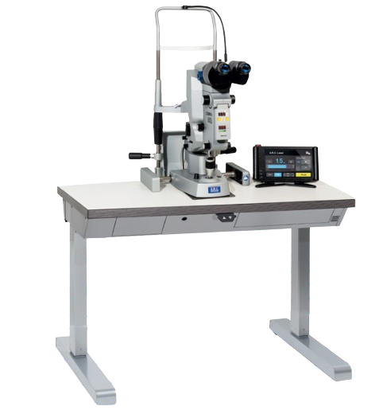
SLIT LAMP TABLE
Space-saving plain design
Wheelchair accessible thanks to the stable two-pillar design
No inconvenient cables
Electric height adjustment:
72 cm – 95 cm table height
→ Optionally available on castors

Slide 12
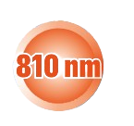
MODERN | SMART | PORTABLE
FOX IV ⁸¹⁰ - DIODE LASER
Glaucoma – Specialist
  energy and time counter
  voice output
  metronome function
Battery powered and portable
High quality metal housing
Power up to 8 W – more than a
Glaucoma Laser;
Additional treatments:
Endo coagulation
LIO application
TCL-DCR
GLAUCOMA (CPC/µCPC)
RETINAL COAGULATION WITH LIO
ENDO-COAGULATION
DCR

Slide 13
ORIGINAL ARGON | PORTABLE | INTUITIVE
FOX ⁵¹⁴ - DIODE LASER
original argon wavelength 514 nm
space saving, portable laser for or
continuous power range of 50 mW – 1,5 W
intuitive operating concept
affordable accessories
ENDOCOAGUATION
RETINAL COAGULATION WITH LIO

Slide 14
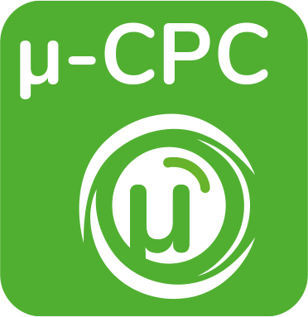



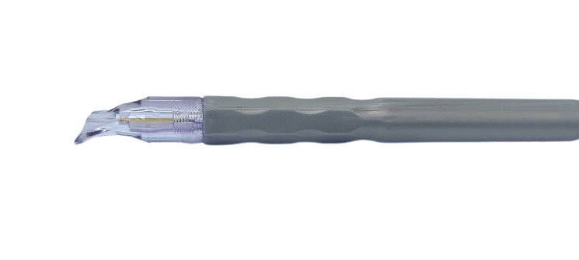

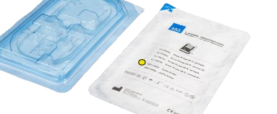


PROBES
FOX ACCESSORIES
µCPC - Probe
Cyclo Probe
DCR
Endo Probe – CURVED (23G/25G)
Endo Probe – STRAIGHT (23G/25G)

Slide 15

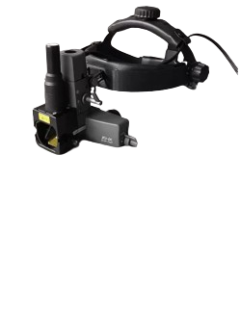
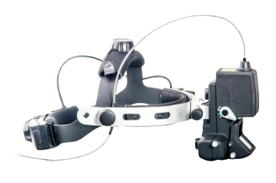
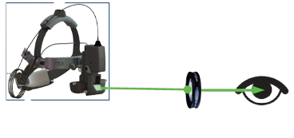
OPHTHALMOSCOPES
FOX ACCESSORIES
For babies and patients who are not able to be treated by a slit lamp based laser
Use of an ophthalmoscopy lens
Keeler for FOX IV 810 and FOX 514
Neitz for FOX IV 810
Notes:
Achtung Keeler mit 810 und 514
Neitz nur mit 810

Slide 16
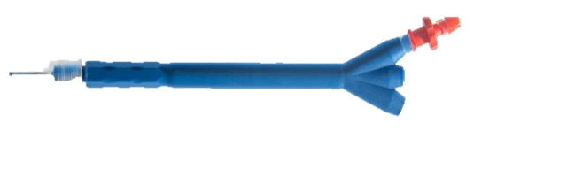
REPUTABLE | PROFITABLE | SAFE
CETUS - NANOLASER
Gentle and Safe for endothelial cells
Cold Laser method for photofragmentation of
the lens nucleus
Typically, only 1% of the energy compared to conventional ultrasound – phaco
No vibration an no thermal effect
Increased safety due to 100% disposable handpieces
Compatible with modern phacosystems
Very Low Maintenance Costs
RLE / CLE
CATARCT SURGERY

Slide 17

A.R.C. Laser
A.R.C. Academy
A.R.C. Laser is more than just a laser manufacturer…
… we are passionate about lasers and dedicated to sharing that passion with the world.
Webinars
Clinical webinars – presented by A.R.C. Laser KOLs
Target group – doctors (existing and potential) & partners
Product webinars – presented by A.R.C. Academy member
Target group – doctors (existing and potential) & partners
Training webinars – presented by A.R.C. Academy member
Target group - partners
Booth Talks during conferences and exhibitions
Booth Lectures – presented by A.R.C. Laser KOLs
Target group – doctors (existing and potential) & partners
Meet the Experts –presented by A.R.C. Academy members and KOLs
Target group – doctors (existing and potential) & partners
https://www.arclaser.com/academy

Slide 18
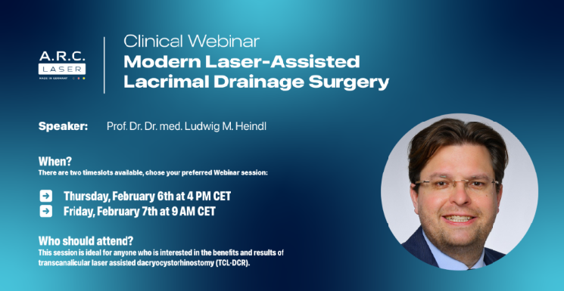
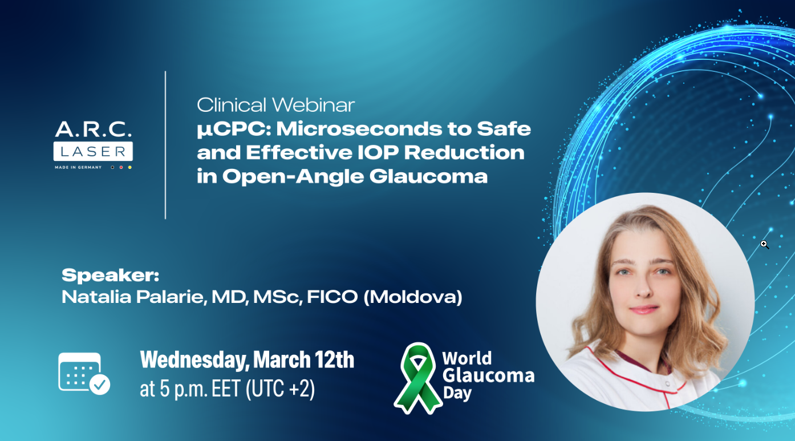
A.R.C. Laser
A.R.C. Academy
Let’s share the mission of A.R.C. Academy with potential costumers and users!
Webinars are available on-demand in our Webinar archive.
https://www.arclaser.com/academy

Slide 19








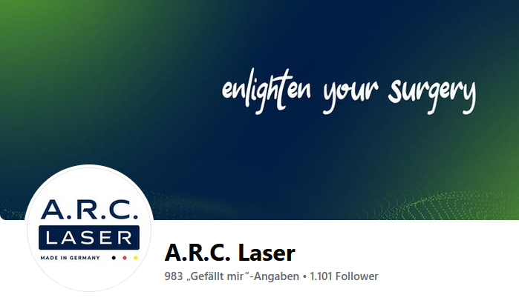
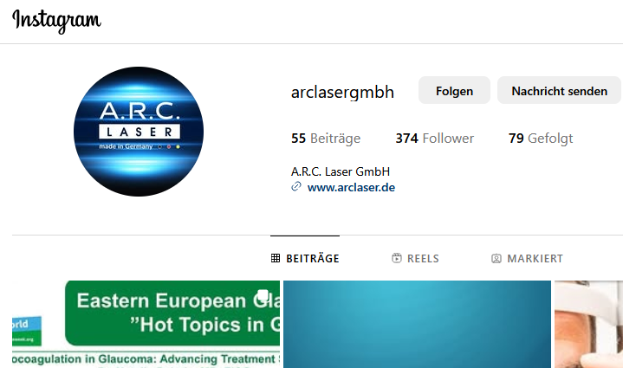
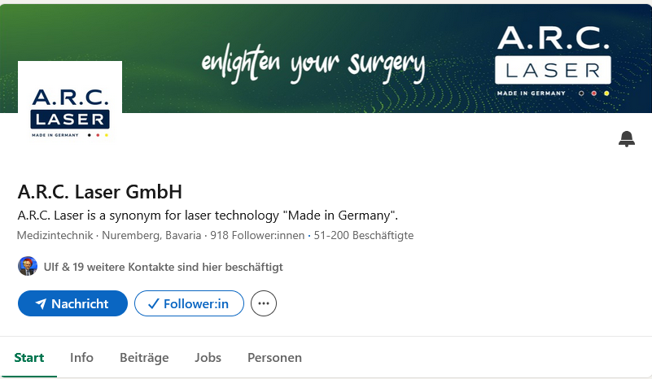
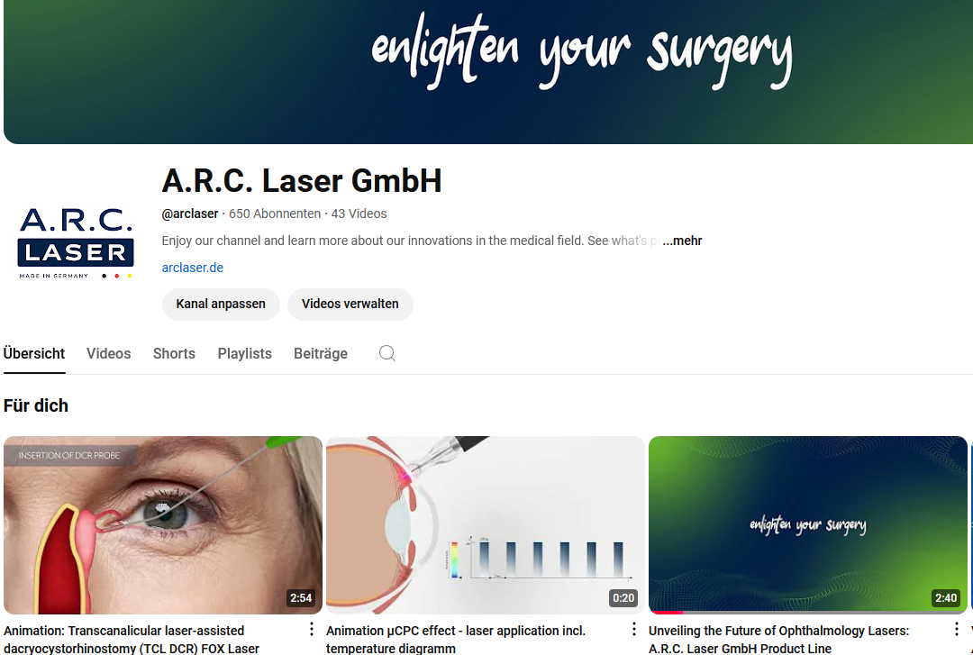
A.R.C. Laser
Social Media
Connect the world!

Slide 20
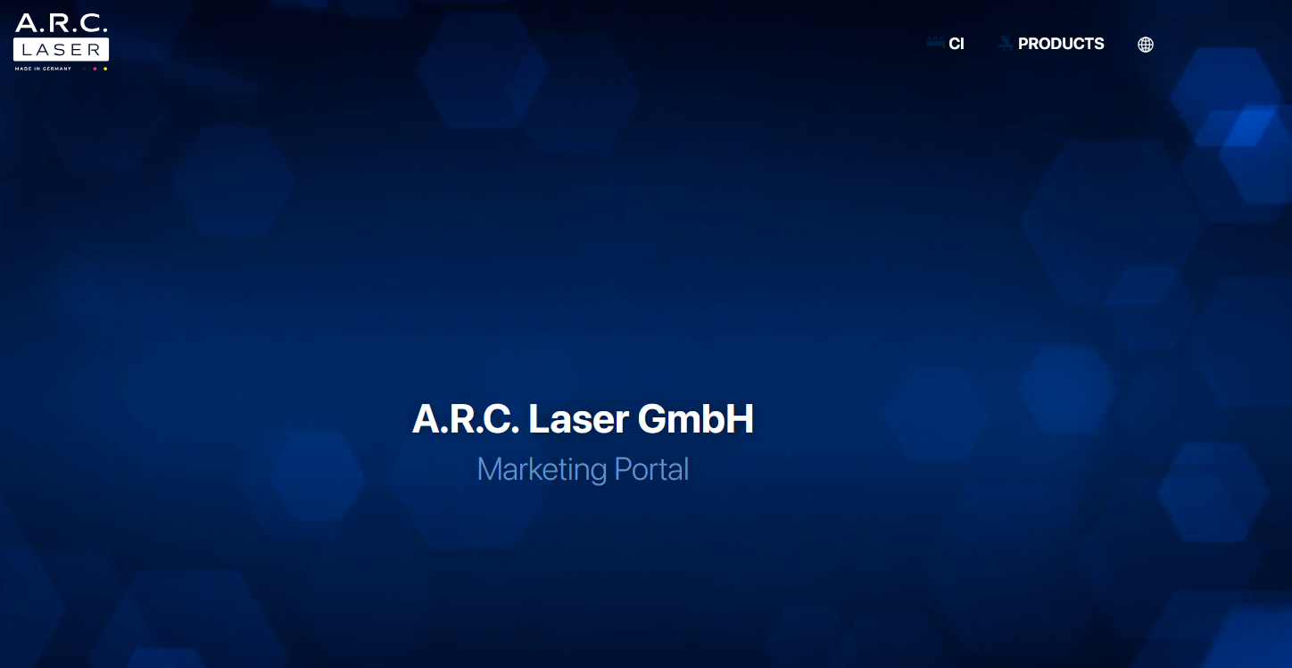
A.R.C. Laser
Marketing Portal
https://marketing.arclaser.com/

Slide 21
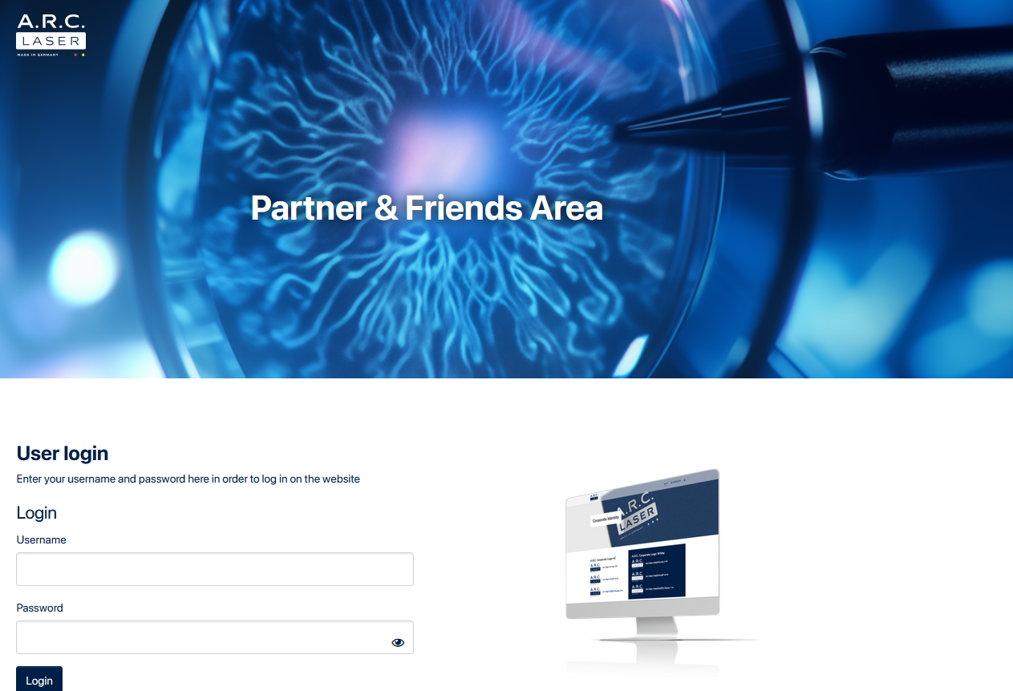
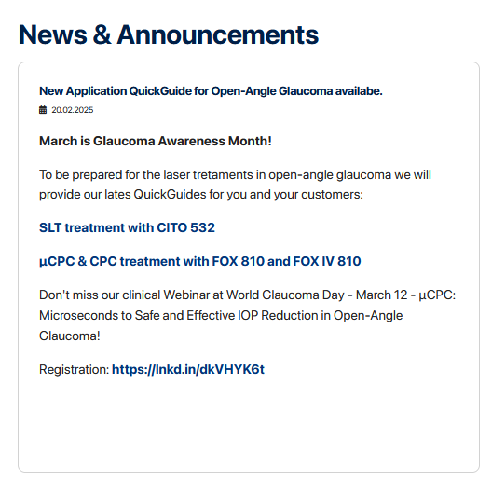
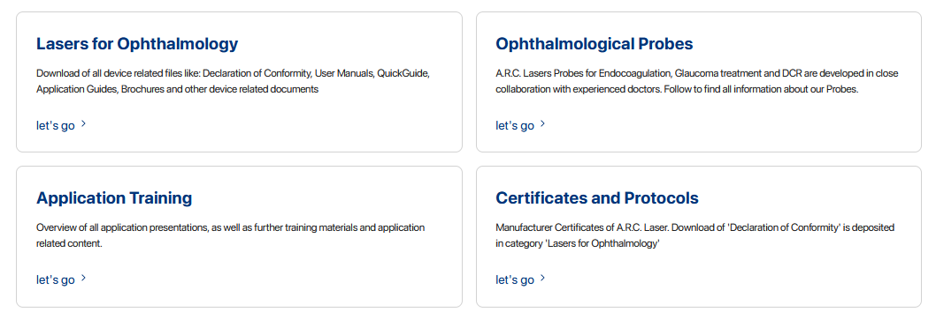
A.R.C. Laser
Partner Area
https://intern.arclaser.com/

Slide 22
