Slide 1
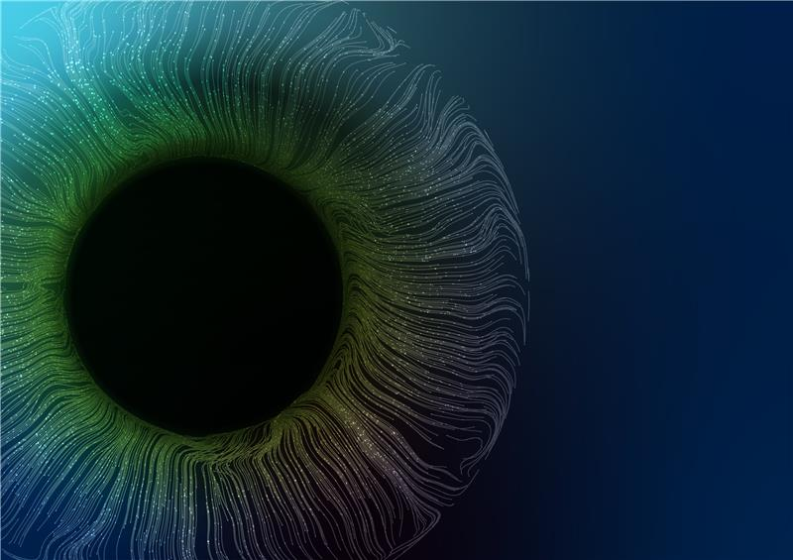

Sales Training
Portfolio Ophthalmology
January, 2026

Slide 2
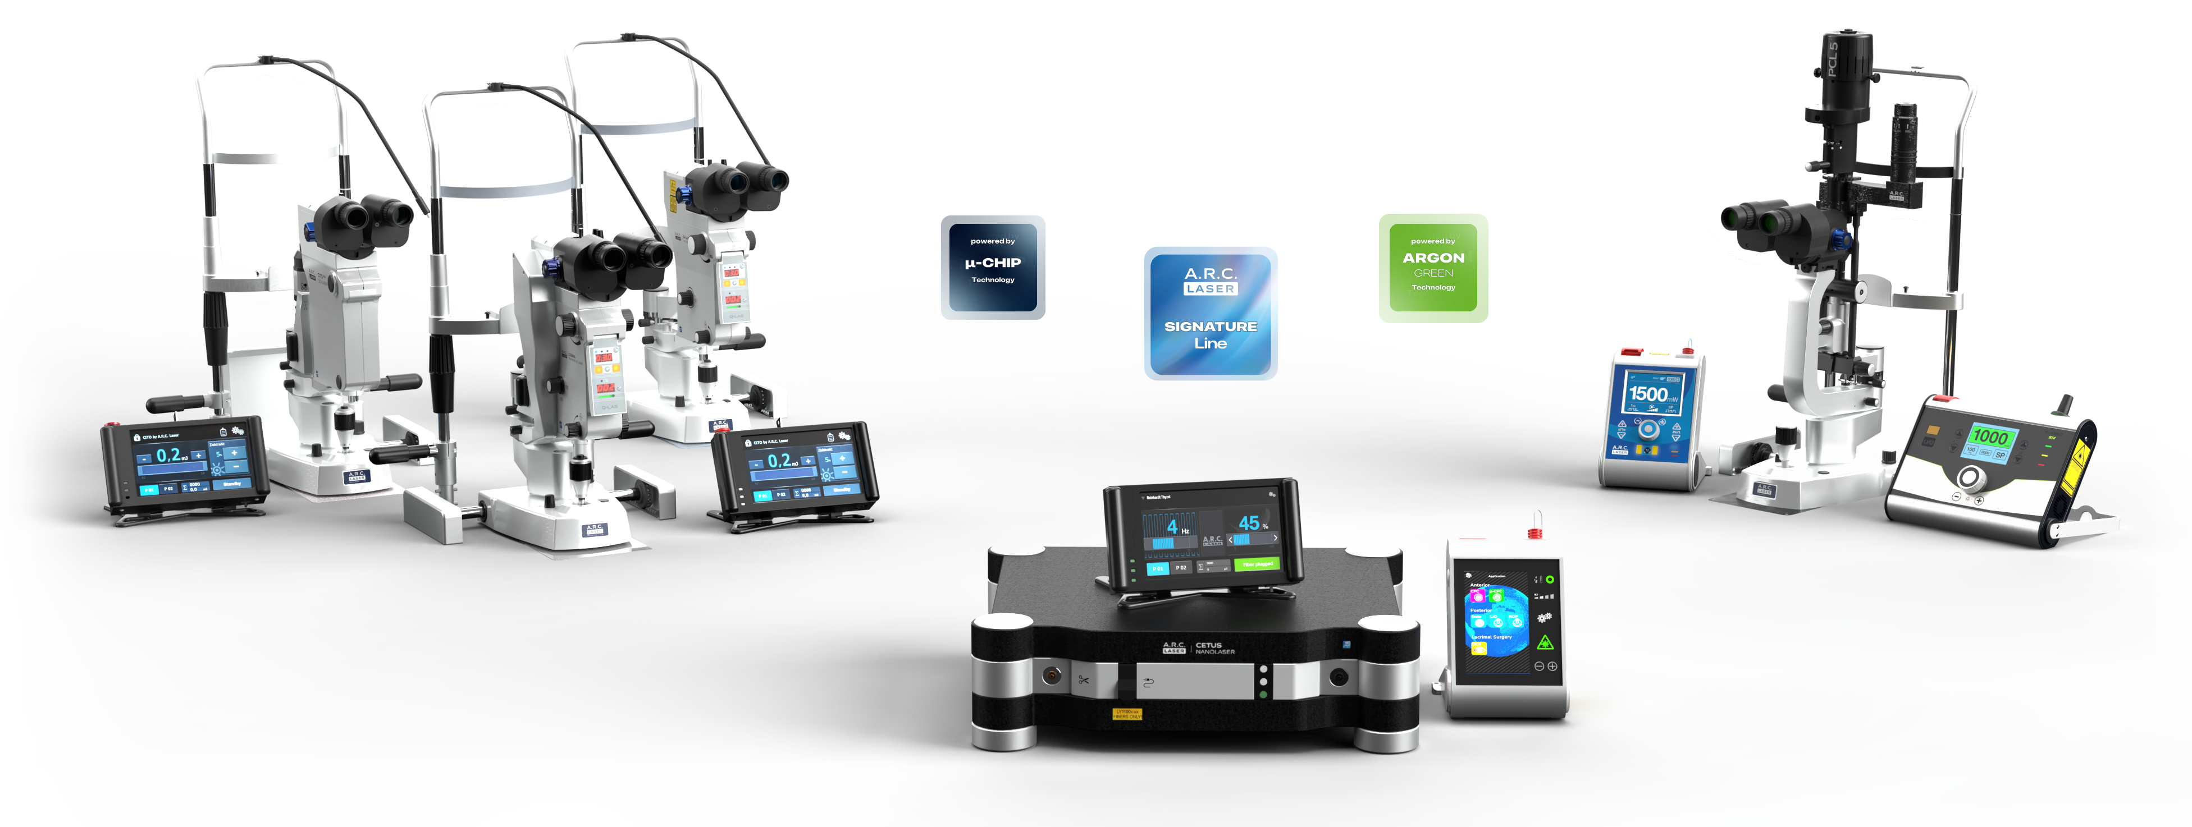
Sales Training – Portfolio Ophthalmology
Product Lines – Categorization – Facts
Notes:
What is Q-switching in a Nd:YAG laser?
Q-switching is a key principle in a Q-switched Nd:YAG laser that allows the laser to produce very short, high-energy pulses.
How it works:
Energy storage:
Energy is pumped into the Nd:YAG crystal while laser oscillation is initially suppressed (low cavity “Q” or quality factor).
Energy release:
When the cavity is rapidly switched to high quality (high Q), the stored energy is released almost instantly.
Result:
This creates an extremely short pulse (typically nanoseconds) with very high peak power.
Why it matters:
Q-switched Nd:YAG lasers generate:
High pulse energy
Very high peak power
Precise, photodisruptive effects

Slide 3
Sales Training – Portfolio Ophthalmology
Product Lines – Categorization – Facts
Q-Las
Classic 514
FOX 514
Cito
Cobra
CETUS
NanoLaser
FOX IV 810
Notes:
What is Q-switching in a Nd:YAG laser?
Q-switching is a key principle in a Q-switched Nd:YAG laser that allows the laser to produce very short, high-energy pulses.
How it works:
Energy storage:
Energy is pumped into the Nd:YAG crystal while laser oscillation is initially suppressed (low cavity “Q” or quality factor).
Energy release:
When the cavity is rapidly switched to high quality (high Q), the stored energy is released almost instantly.
Result:
This creates an extremely short pulse (typically nanoseconds) with very high peak power.
Why it matters:
Q-switched Nd:YAG lasers generate:
High pulse energy
Very high peak power
Precise, photodisruptive effects

Slide 4
Sales Training – Portfolio Ophthalmology
Product Lines – Categorization – Facts
Cito 532
Q-Las
Cobra
CETUS
NanoLaser
FOX IV 810
FOX 514
Classic 514
SLT – Laser;
Frequency doubled Nd:YAG Laser
Nd:YAG;
Q-switched
Combination; switch between
SLT & Nd:YAG
Nd:YAG;
Q-switched
Diode laser
Diode Laser
Diode Laser
532 nm
VIS green
1064 nm
IR
1064 nm
810 nm
514 nm
514 nm
Pulsed lasers
Laser Class 3B
Pulsed laser
Laser Class 1
cw laser
Laser class 4
cw laser
Laser class 4
Application parameter
Energy
Application parameter
Energy / %
Application parameter
Power – Time (pulse duration)
Application parameter
Power – Time (pulse duration)
Free beam application via slit lamp
Fiber guided lasers
Consumables (Ophthalmic Probes)
Fiber guided lasers
Consumables (Endo Probes)
Free beam application via slit lamp
400 µm spot size, fix
Focused spot size < 10 µm, fix
Tissue interaction not by laser!
Laser induced shockwave is used.
Variable spot size
50 – 600 µm
Notes:
What is Q-switching in a Nd:YAG laser?
Q-switching is a key principle in a Q-switched Nd:YAG laser that allows the laser to produce very short, high-energy pulses.
How it works:
Energy storage:
Energy is pumped into the Nd:YAG crystal while laser oscillation is initially suppressed (low cavity “Q” or quality factor).
Energy release:
When the cavity is rapidly switched to high quality (high Q), the stored energy is released almost instantly.
Result:
This creates an extremely short pulse (typically nanoseconds) with very high peak power.
Why it matters:
Q-switched Nd:YAG lasers generate:
High pulse energy
Very high peak power
Precise, photodisruptive effects
1. CW Laser (Continuous-Wave Laser)
Operation: Emits a continuous, steady beam of light.
Output: Constant power over time.
Pulse duration: Essentially infinite (continuous).
Peak power: Relatively low compared to pulsed lasers at the same average power.
Uses: Cutting, welding, engraving, certain ophthalmic procedures where constant energy is desired.
2. Pulsed Laser
Operation: Emits light in short bursts (pulses) rather than continuously.
Pulse duration: Can range from milliseconds to femtoseconds, depending on the laser type.
Peak power: Much higher than CW lasers because energy is concentrated in short pulses.
Uses: Precision ablation, photodisruption in ophthalmology (e.g., Q-switched Nd:YAG for capsulotomy), tattoo removal, micromachining.

Slide 5
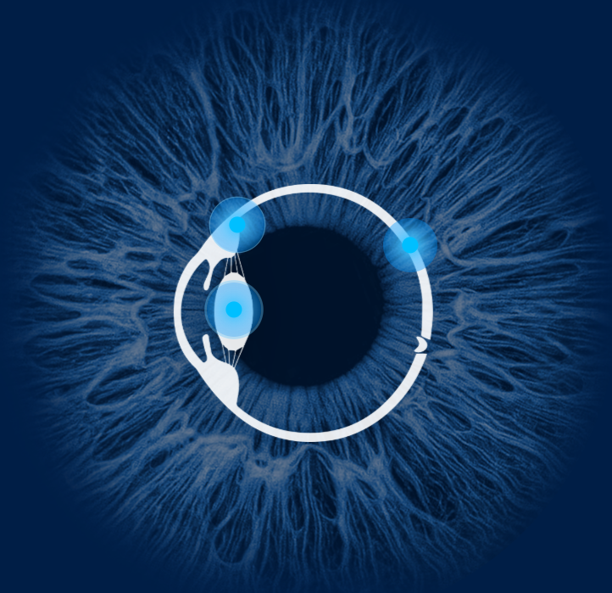
Sales Training – Portfolio Ophthalmology
Product Lines – Categorization – Indications
Q-Las
FOX 514
Classic 514
Cito
Cobra
FOX IV 810
CETUS
NanoLaser
Anterior segment
of the eye
Posterior segment
of the eye
Notes:
What is Q-switching in a Nd:YAG laser?
Q-switching is a key principle in a Q-switched Nd:YAG laser that allows the laser to produce very short, high-energy pulses.
How it works:
Energy storage:
Energy is pumped into the Nd:YAG crystal while laser oscillation is initially suppressed (low cavity “Q” or quality factor).
Energy release:
When the cavity is rapidly switched to high quality (high Q), the stored energy is released almost instantly.
Result:
This creates an extremely short pulse (typically nanoseconds) with very high peak power.
Why it matters:
Q-switched Nd:YAG lasers generate:
High pulse energy
Very high peak power
Precise, photodisruptive effects

Slide 6
Sales Training – Portfolio Ophthalmology
Product Lines – Categorization – Indications
Cito
SLT – Selective Laser Trabeculoplasty
Glaucoma (Open angle)
Trabecular Meshwork
Q-Las
Capsulotomy
PCO
(posterior-capsule opacification) aka secondary cataract
Posterior capsule membrane
Cobra
Iridotomy
Glaucoma (angle-closure)
Iris
CETUS
NanoLaser
Photofragmentation
of lens nucleus
Cataract (soft-medium nucleus)
Refractive Lens Exchange (RLE)
lens
FOX IV 810
Cyclophotocoagulation
(CPC – sCPC - µCPC)
Glaucoma (open angle)
Ciliary body (processes and muscle)
Retinal coagulation by
Endo Probes (invasive)
LIO (non-invasive)
Retinal detachment, bleeding, holes
Retinopathy of prematurity (ROP)
Retina
TCL-DCR (Trans-canalicular Laser assisted Dacrycystorhinostomy)
Inflammation of lacrimal duct →Tearing eye
Tear duct
(post-saccale stenosis)
FOX 514
Retinal coagulation by
Endo Probes (invasive)
LIO (non-invasive)
Retinal detachment, bleeding, holes
Retinopathy of prematurity (ROP)
Retina
Classic 514
Retinal coagulation and retinal therapx by Slit lamp (non-invasive)
Retinal coagulation
in detachment, bleeding, holes;
Retinal therapy in macular edema
Retina
Notes:
What is Q-switching in a Nd:YAG laser?
Q-switching is a key principle in a Q-switched Nd:YAG laser that allows the laser to produce very short, high-energy pulses.
How it works:
Energy storage:
Energy is pumped into the Nd:YAG crystal while laser oscillation is initially suppressed (low cavity “Q” or quality factor).
Energy release:
When the cavity is rapidly switched to high quality (high Q), the stored energy is released almost instantly.
Result:
This creates an extremely short pulse (typically nanoseconds) with very high peak power.
Why it matters:
Q-switched Nd:YAG lasers generate:
High pulse energy
Very high peak power
Precise, photodisruptive effects
1. CW Laser (Continuous-Wave Laser)
Operation: Emits a continuous, steady beam of light.
Output: Constant power over time.
Pulse duration: Essentially infinite (continuous).
Peak power: Relatively low compared to pulsed lasers at the same average power.
Uses: Cutting, welding, engraving, certain ophthalmic procedures where constant energy is desired.
2. Pulsed Laser
Operation: Emits light in short bursts (pulses) rather than continuously.
Pulse duration: Can range from milliseconds to femtoseconds, depending on the laser type.
Peak power: Much higher than CW lasers because energy is concentrated in short pulses.
Uses: Precision ablation, photodisruption in ophthalmology (e.g., Q-switched Nd:YAG for capsulotomy), tattoo removal, micromachining.

Slide 7
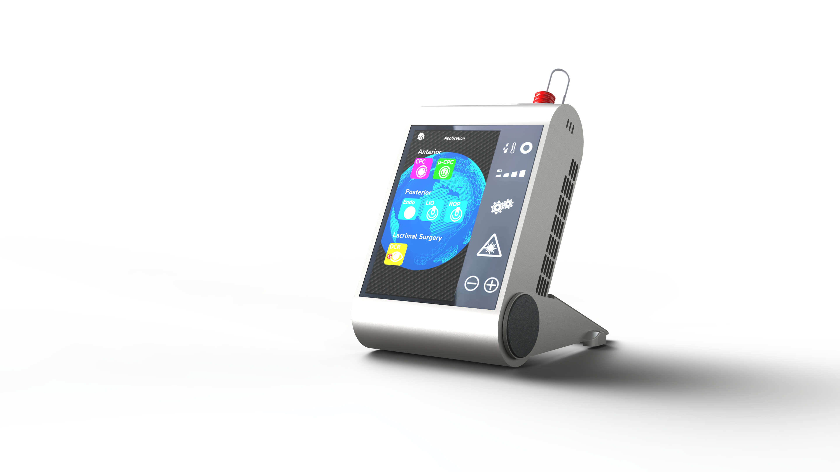
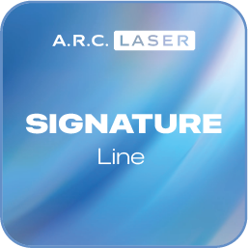
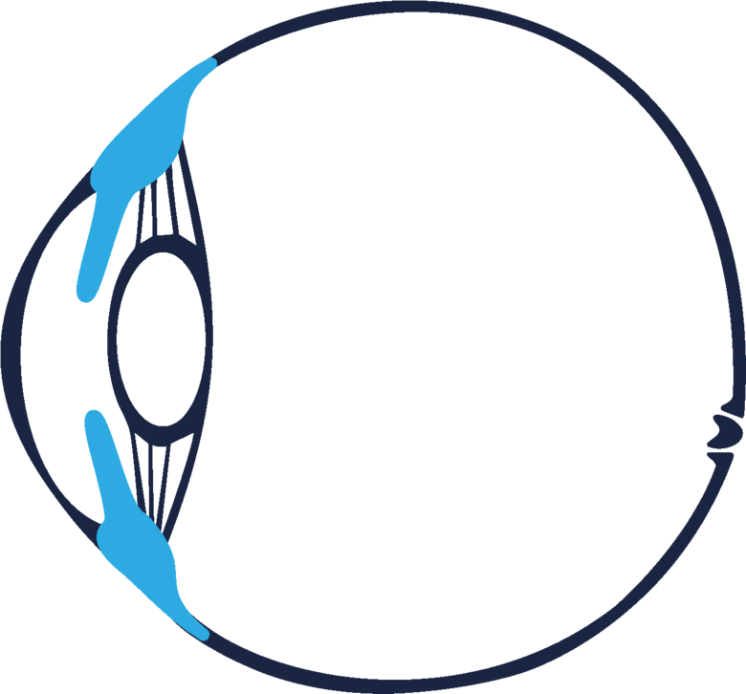
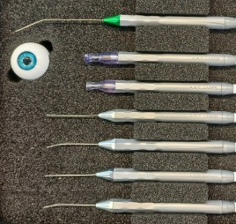
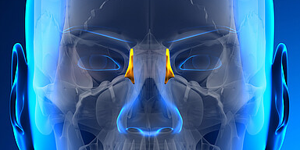
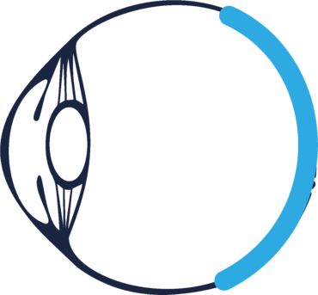
Sales Training – Portfolio Ophthalmology
A.R.C. Laser – Signature Line
  FOX IV 810
  Diode Laser 810 nm
    Glaucoma treatment
      CPC
      sCPC
      µCPC
    Retina coagulation by use of
      Endo Probes and
      LIO, ROP
    Tear Duct
      DCR
Open angle Glaucoma
DCR Probe
Cyclo Probe
µCPC Probe
Post-saccal stenosis in tear duct
Endo Probes
Straight & curved,
23 & 25 G
Retina coagulation

Slide 8
Sales Training – Portfolio Ophthalmology
A.R.C. Laser – Signature Line
  FOX IV 810
  Diode Laser 810 nm
  USPs
  Wide range of applications
  Up to 8 W power output – 3 W max. in competitor devices
  Most handy and lightweight device in ophthalmology
  Battery-powered & fully portable
  Portable with product fitted transportation box
  Unique simplified and effective handling of patented µCPC Probe
  Advanced Energy & Time Control
    Voice guidance available in 5 languages
    Integrated metronome for application speed guidance
    Protocol function
  Breakthrough in Lacrimal surgery
    Expands the range of applications to a new level with virtually no competition
Open angle Glaucoma
Post-saccal stenosis in tear duct
Retina coagulation

Slide 9
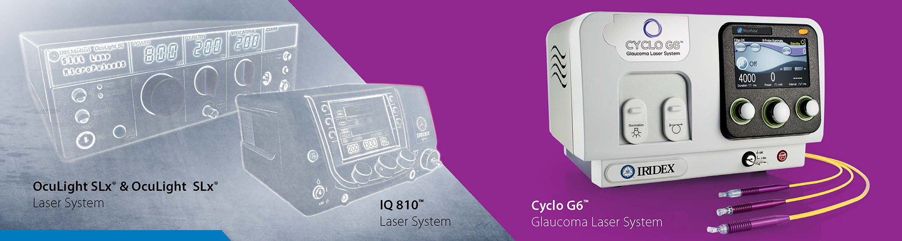
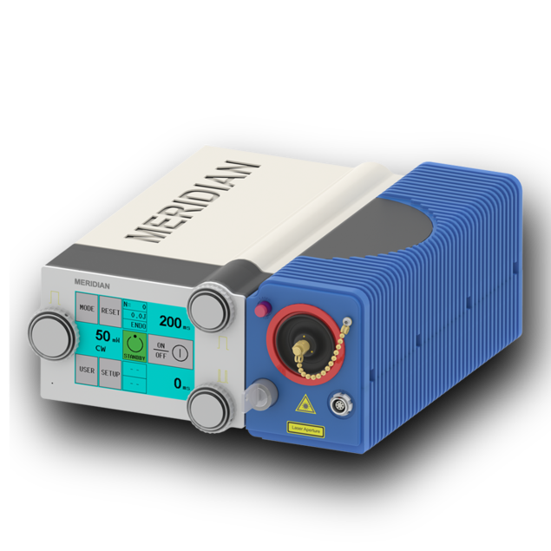
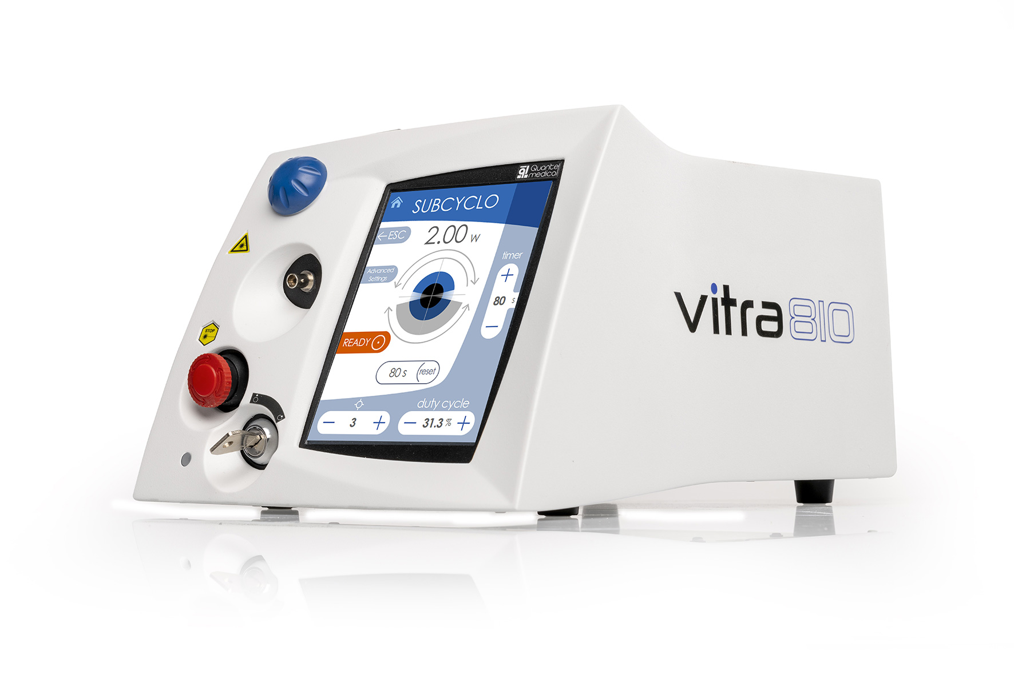
Sales Training – Portfolio Ophthalmology
A.R.C. Laser – Signature Line
  FOX IV 810
  Diode Laser 810 nm
  The one and only all-round laser in ophthalmology
  with up to 8 W power!
  Competitors - Glaucoma
  Iridex Cyclo G 6
  Quantel Vitra 810
  (Meridian)
Open angle Glaucoma
Post-saccal stenosis in tear duct
Retina coagulation

Slide 10
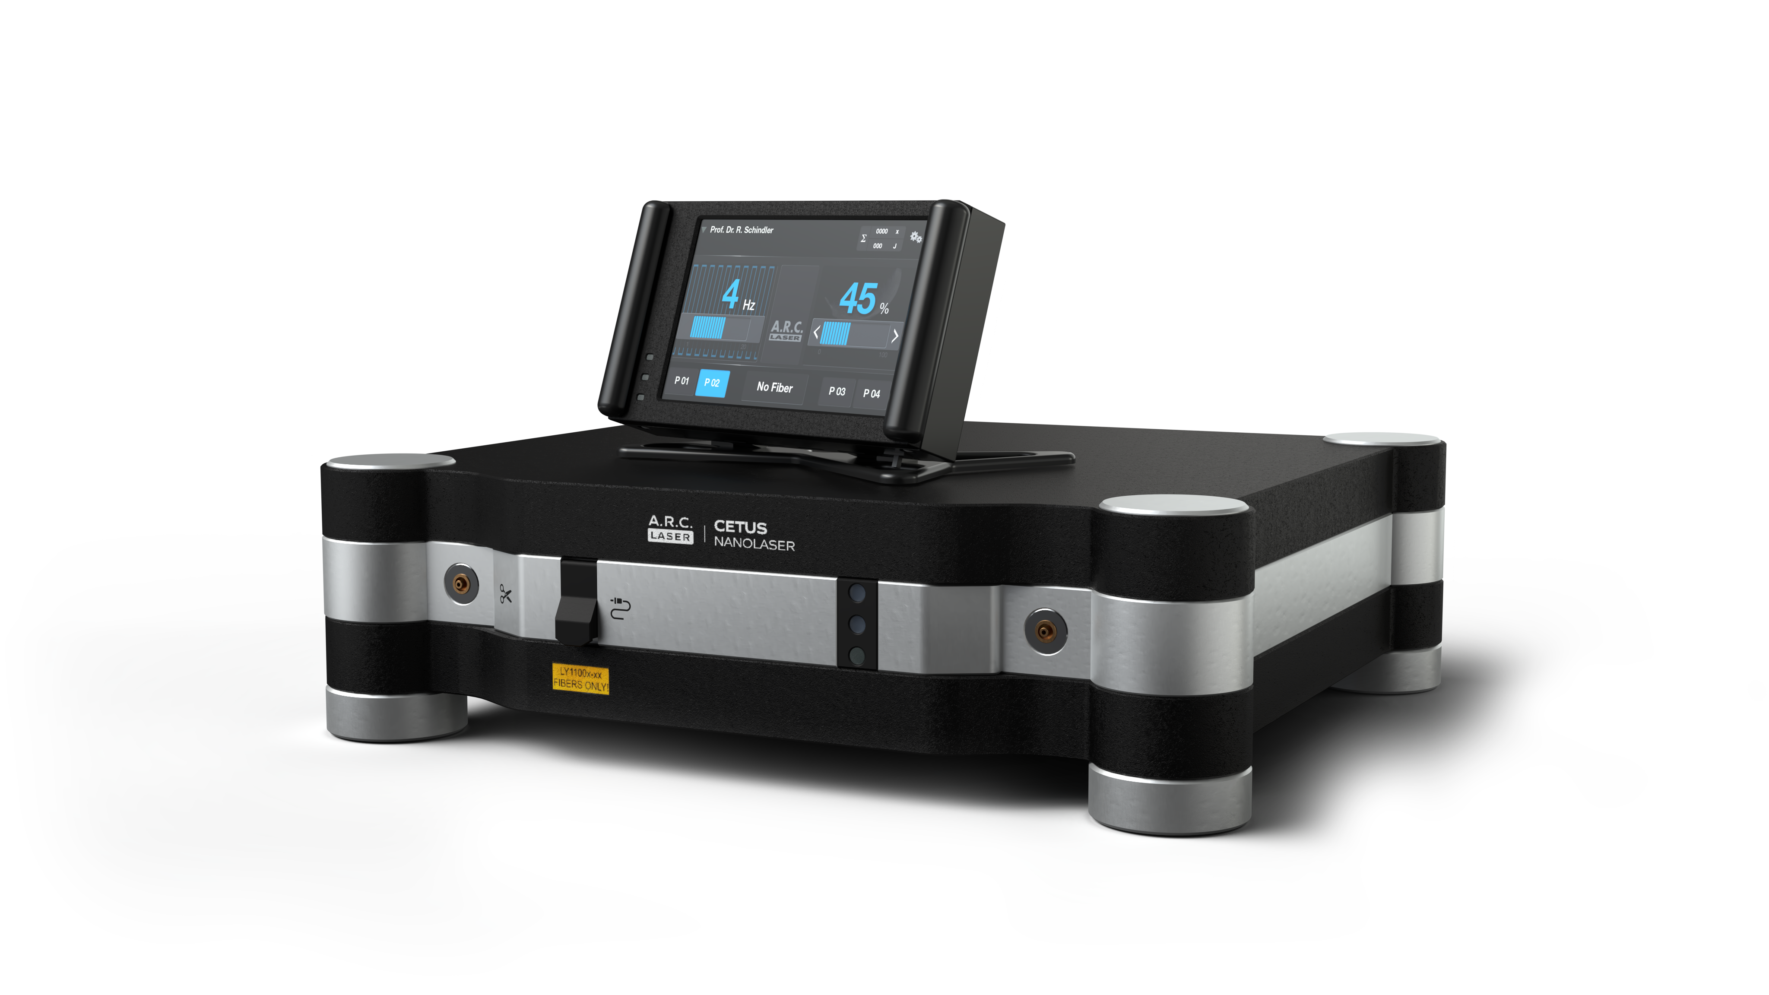
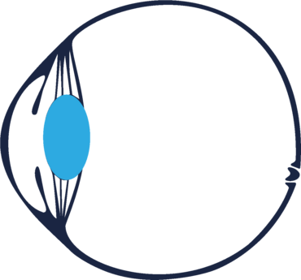
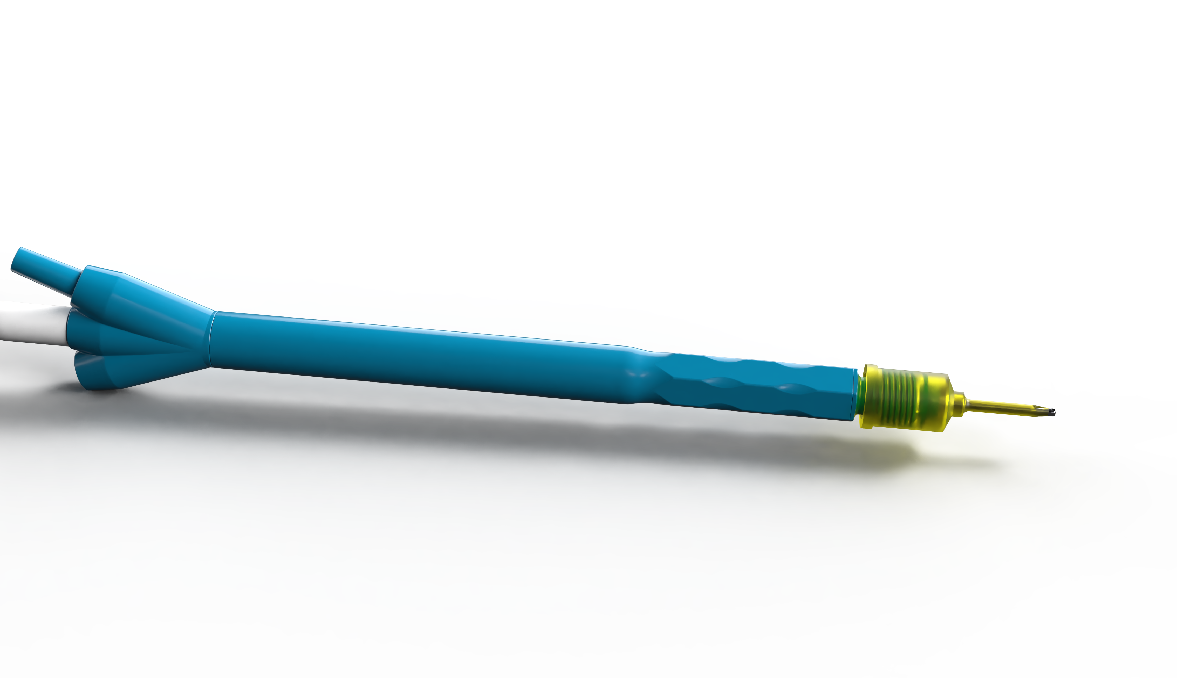
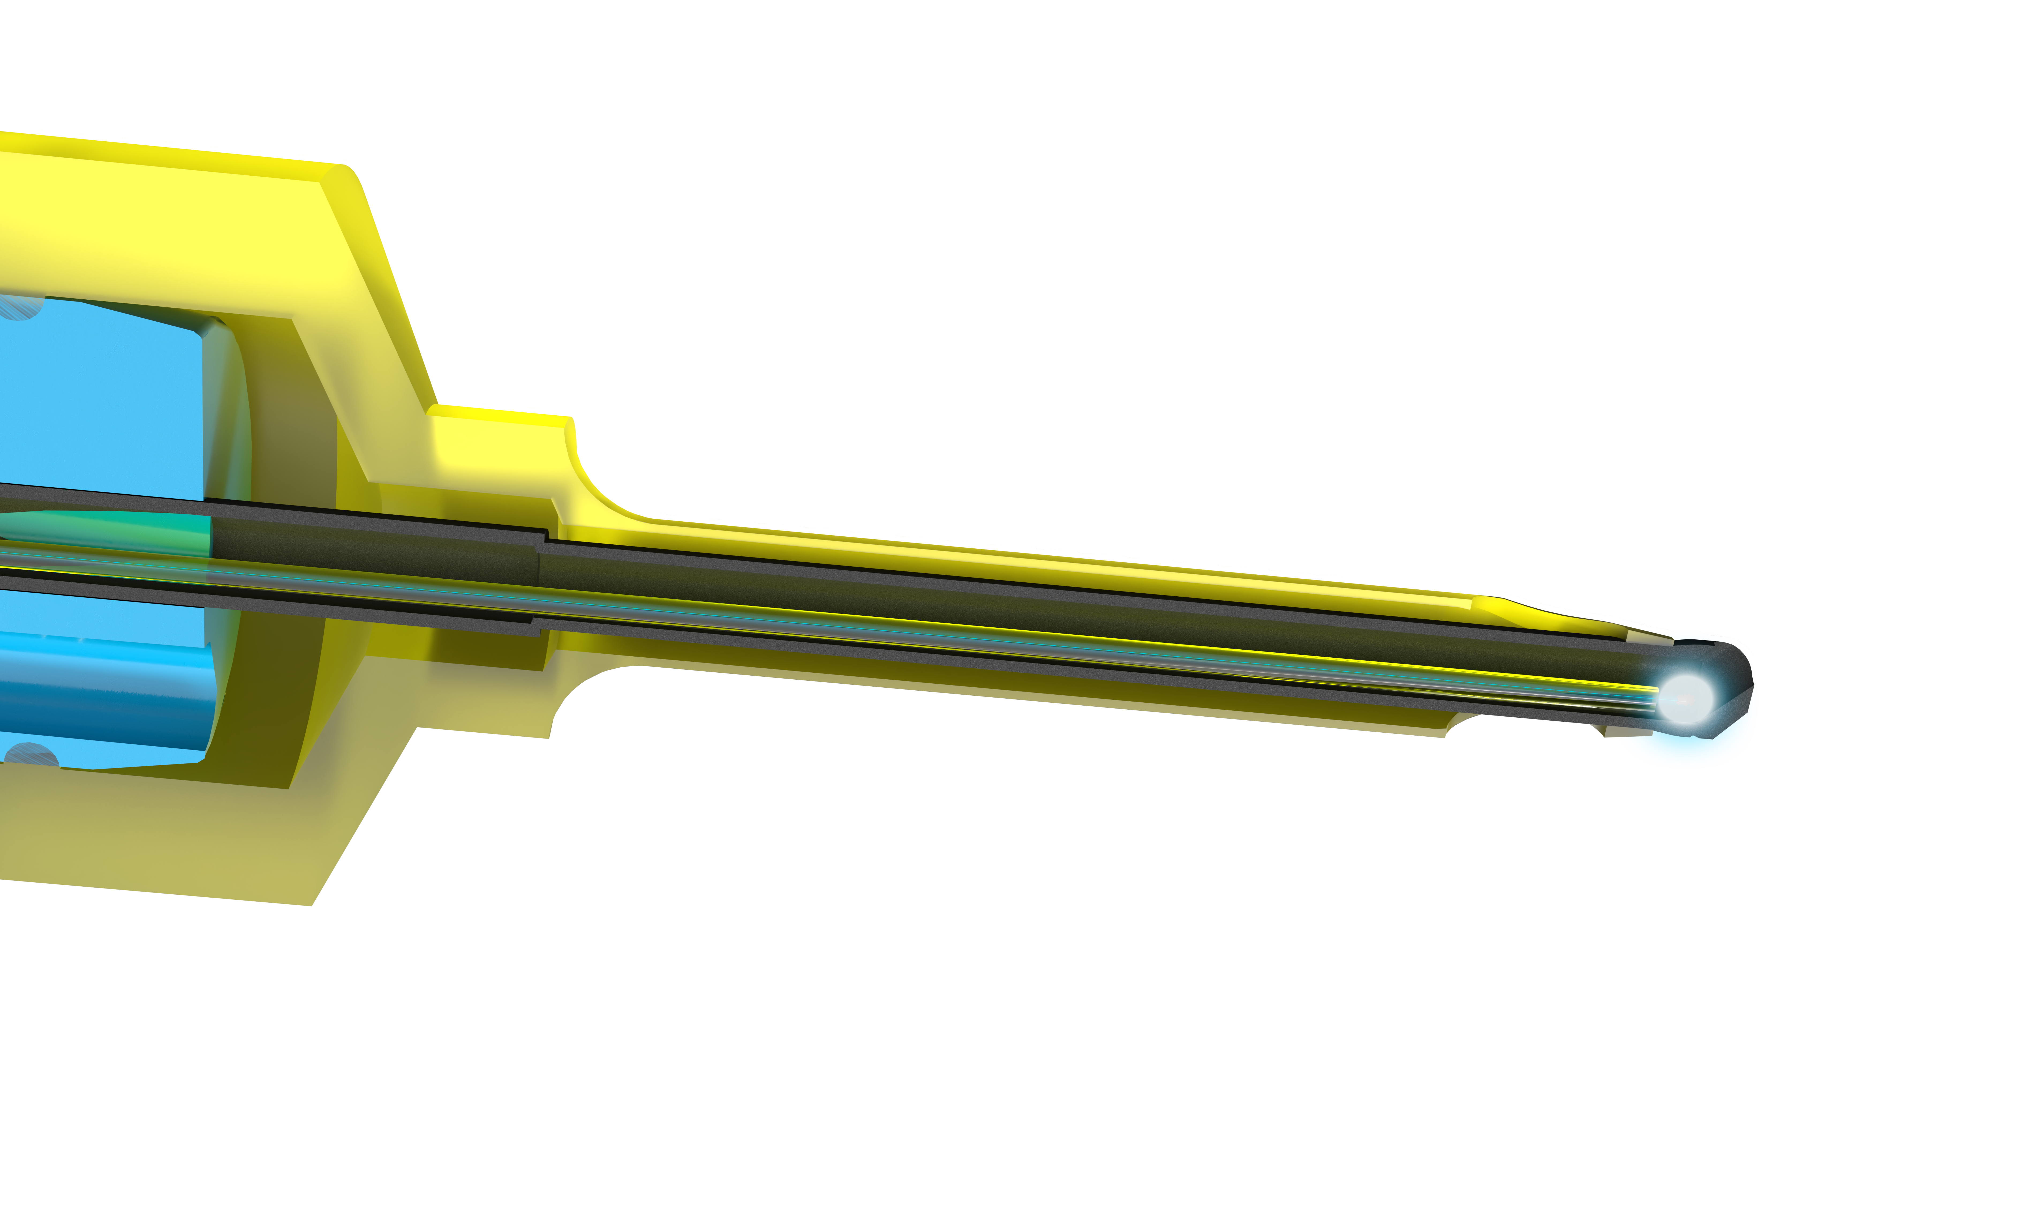
Sales Training – Portfolio Ophthalmology
A.R.C. Laser – Signature Line
  NanoLaser CETUS
  Cataract
  – soft to medium hard nucleus
  RLE
Cataract &
Refractive Lens exchange RLE

Slide 11
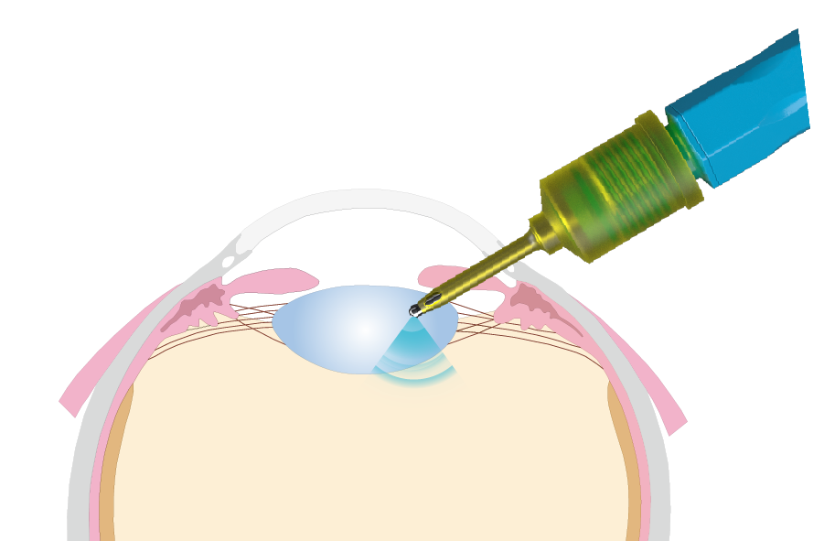
Sales Training – Portfolio Ophthalmology
A.R.C. Laser – Signature Line
  NanoLaser CETUS
  USPs
  No competition !!!
  The one and only 100 % laser lens surgery with complete single use probes for highest hygienic standards
  Femto-lasers offers only assisted laser surgery – treatment preparation with additional energy
  Ultrasound is based on high energy input, heat and vibration
  Endothelial damage
Cataract &
Refractive Lens exchange RLE

Slide 12
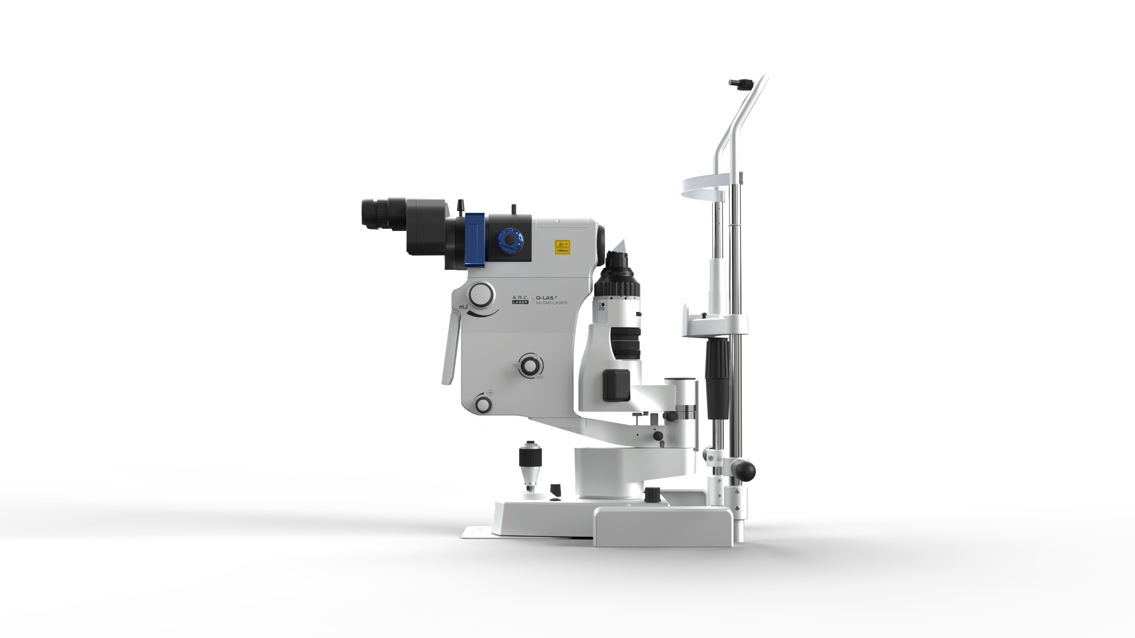
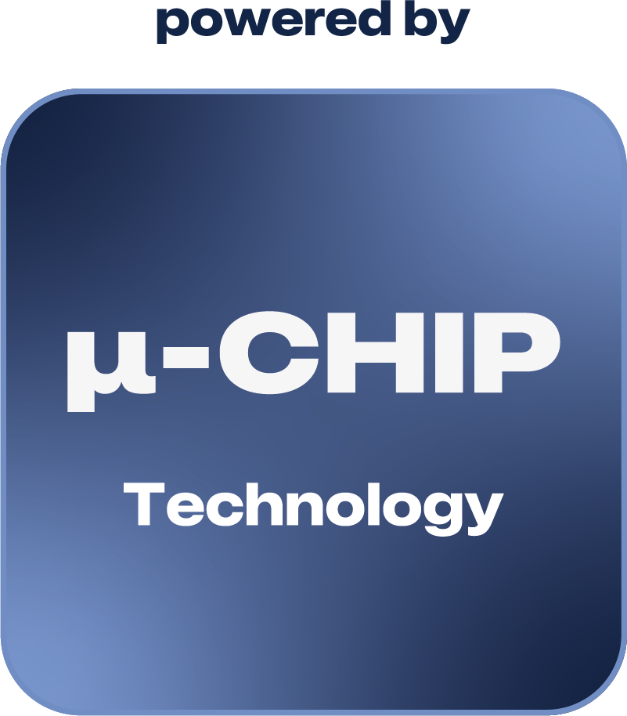
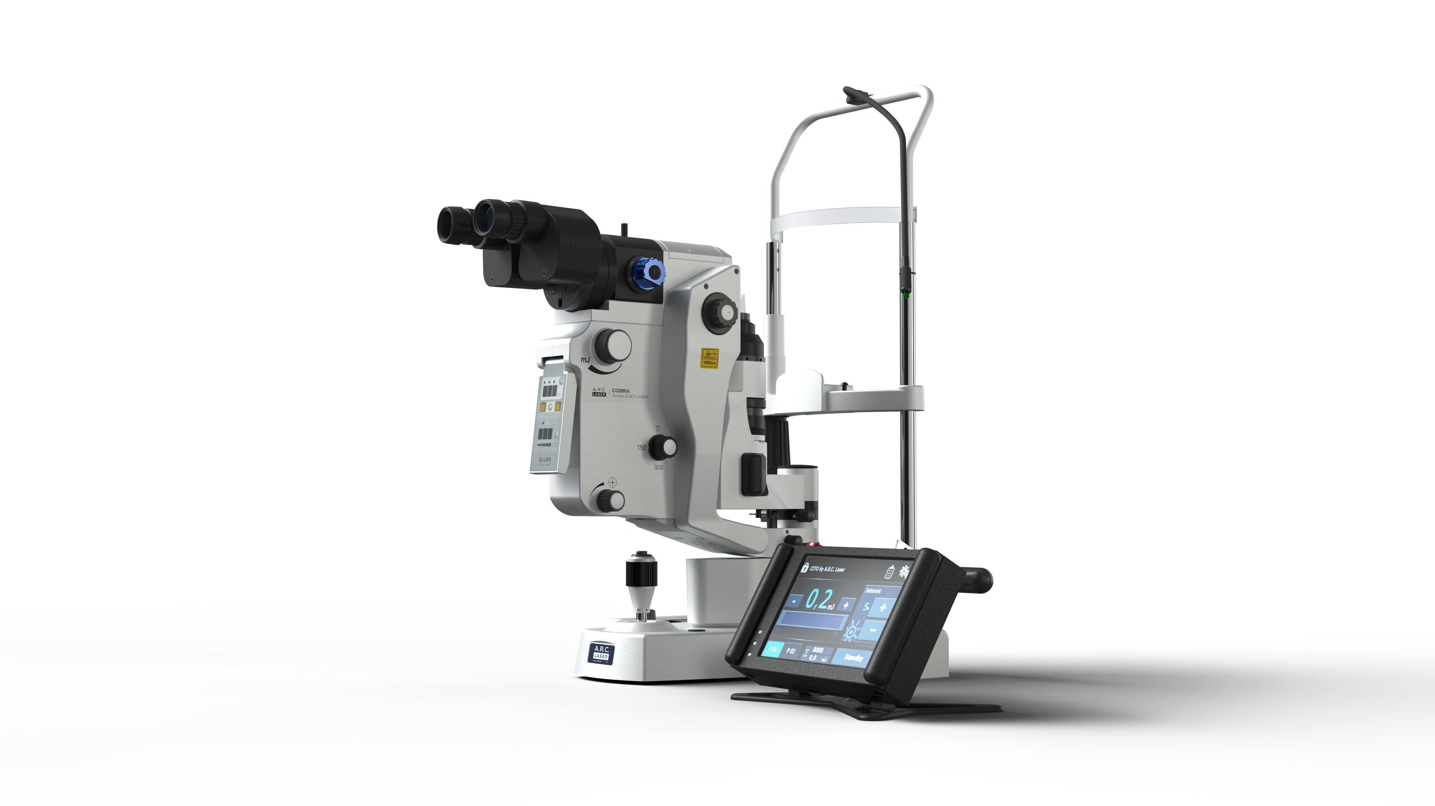
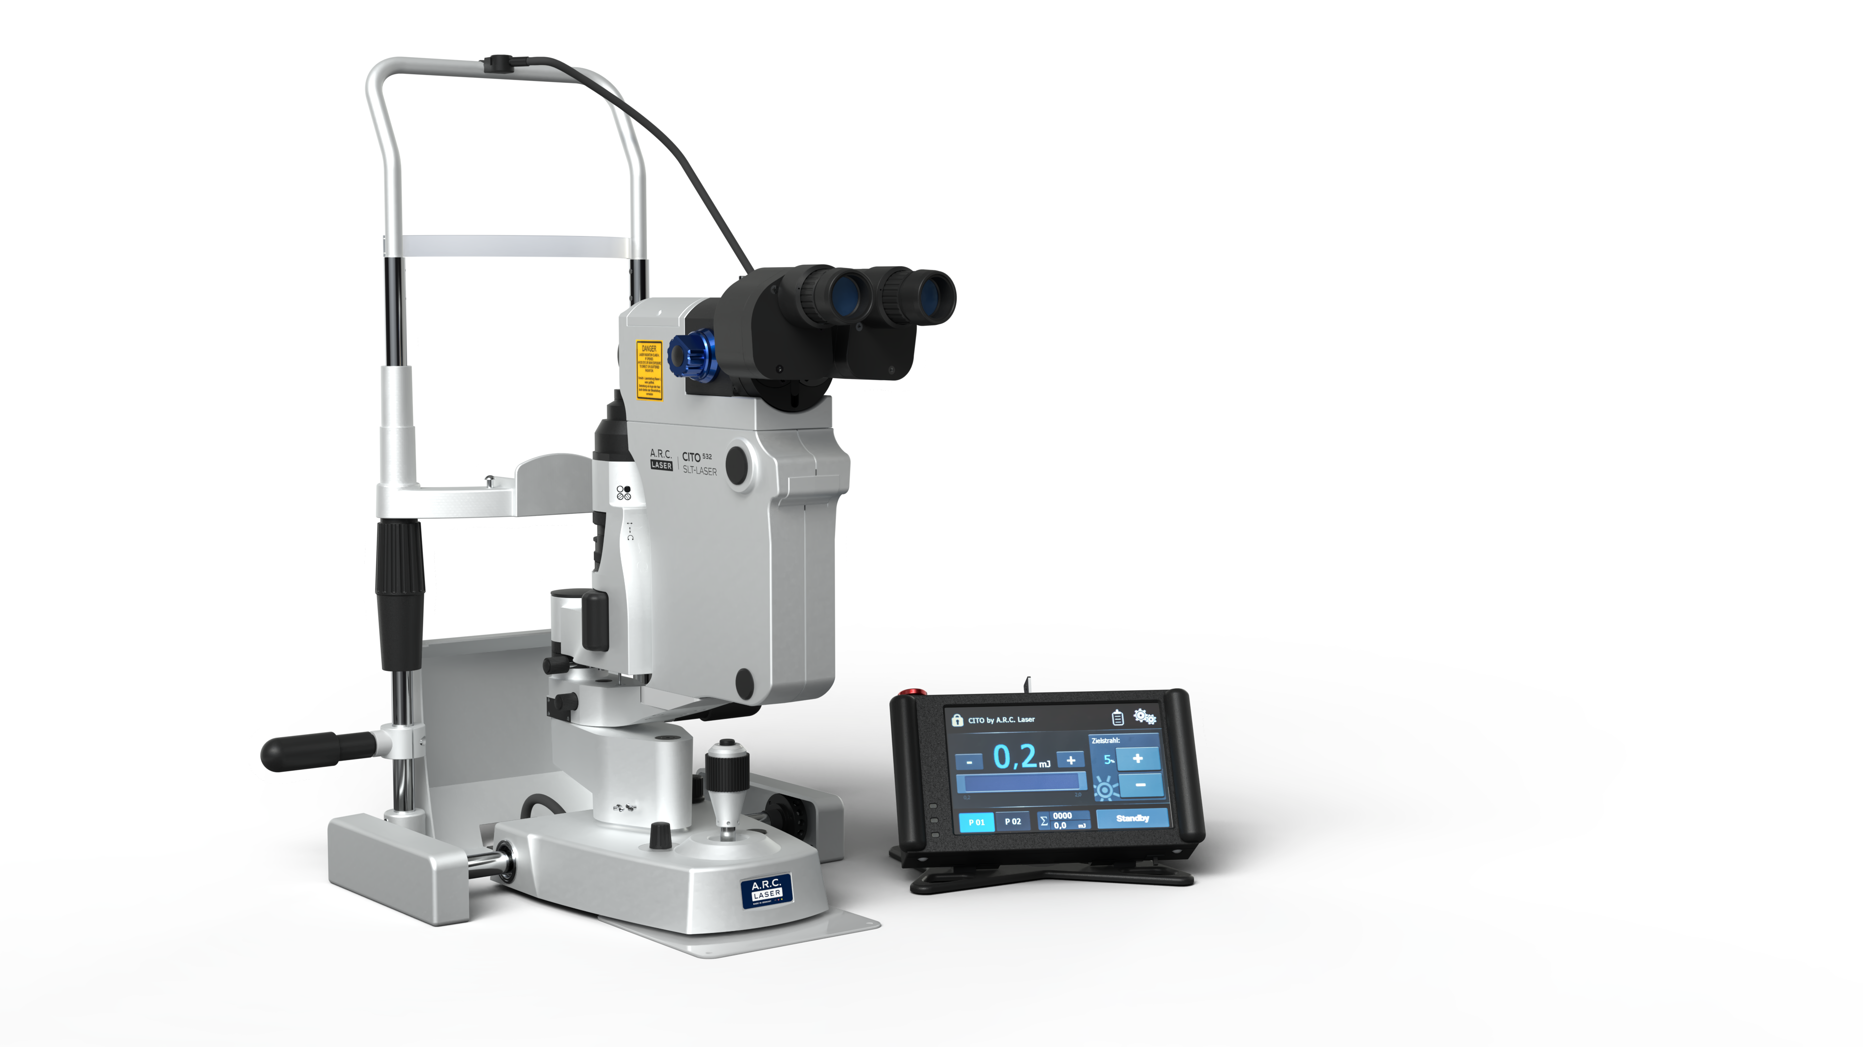
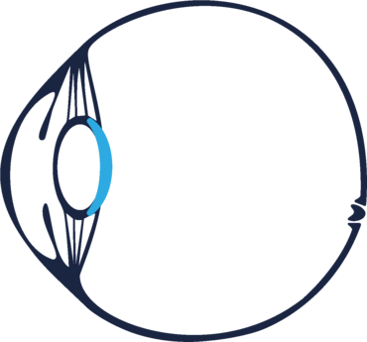
Sales Training – Portfolio Ophthalmology
A.R.C. Laser - µ-CHIP Technology Line
  Q-Las
  Nd:YAG Laser
  Capsulotomy
  Iridotomy
COBRA
SLT+Nd:YAG Laser
  Capsulotomy
  Iridotomy
  SLT
Open angle Glaucoma
Closed Angle Glaucoma
  Cito 532
  SLT-Laser
  SLT
Secondary Cataract /
PCO: Posterior Capsule Opacification

Slide 13
Sales Training – Portfolio Ophthalmology
A.R.C. Laser - µ-CHIP Technology Line
  µ-Chip Technology Line
  USPs
  Diode pumped laser cavities offers:
  High efficiency
  Great pulse-to-pulse stability
  Ensures consistent performance and reliable clinical outcomes.
  Extended Lifetime
  No degradation from heat or UV exposure, resulting in significantly longer operational durability
  QuickRepetition Technology
  Enables the world’s fastest repetition rates—up to 10 Hz in ophthalmic applications, enhancing workflow speed and treatment efficiency.
Open angle Glaucoma
Closed Angle Glaucoma
Secondary Cataract /
PCO: Posterior Capsule Opacification

Slide 14
Sales Training – Portfolio Ophthalmology
A.R.C. Laser - µ-CHIP Technology Line
  µ-Chip Technology Line
  Competitor Companies
  Ellex – Lumibird – Australia
  Lightmed – Taiwan
  Lumenis - Israel
  Meridian - Switzerland
  Nidek – Japan
  Optotek Medical – Lumibird – Slovenia
  Quantel – Lumibird – France
  ZEISS - Germany
Open angle Glaucoma
Closed Angle Glaucoma
Secondary Cataract /
PCO: Posterior Capsule Opacification

Slide 15
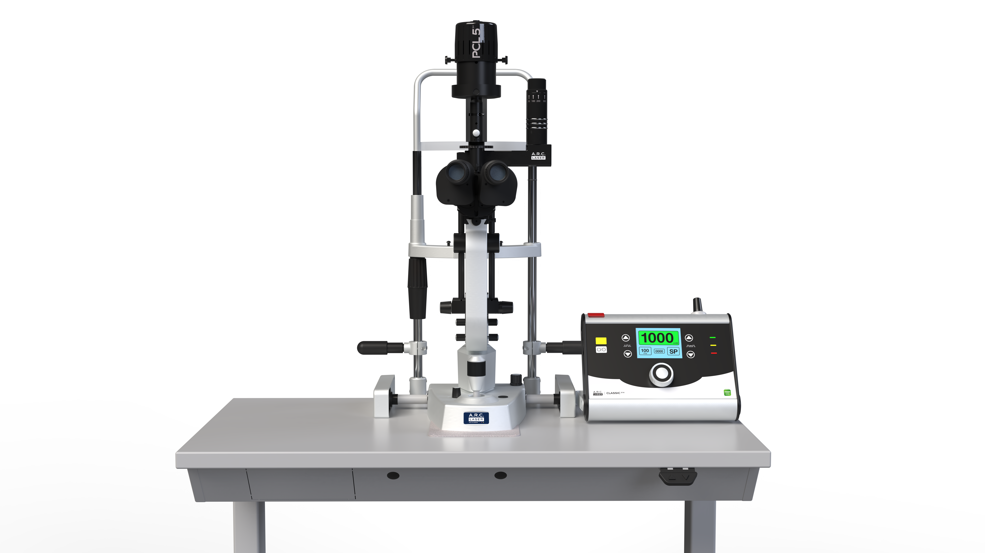
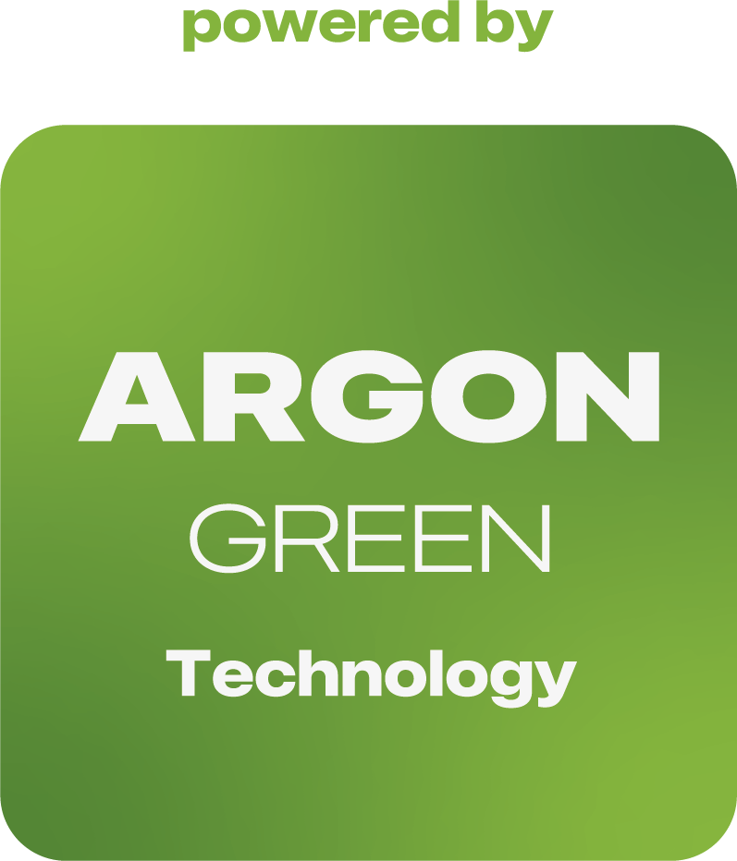
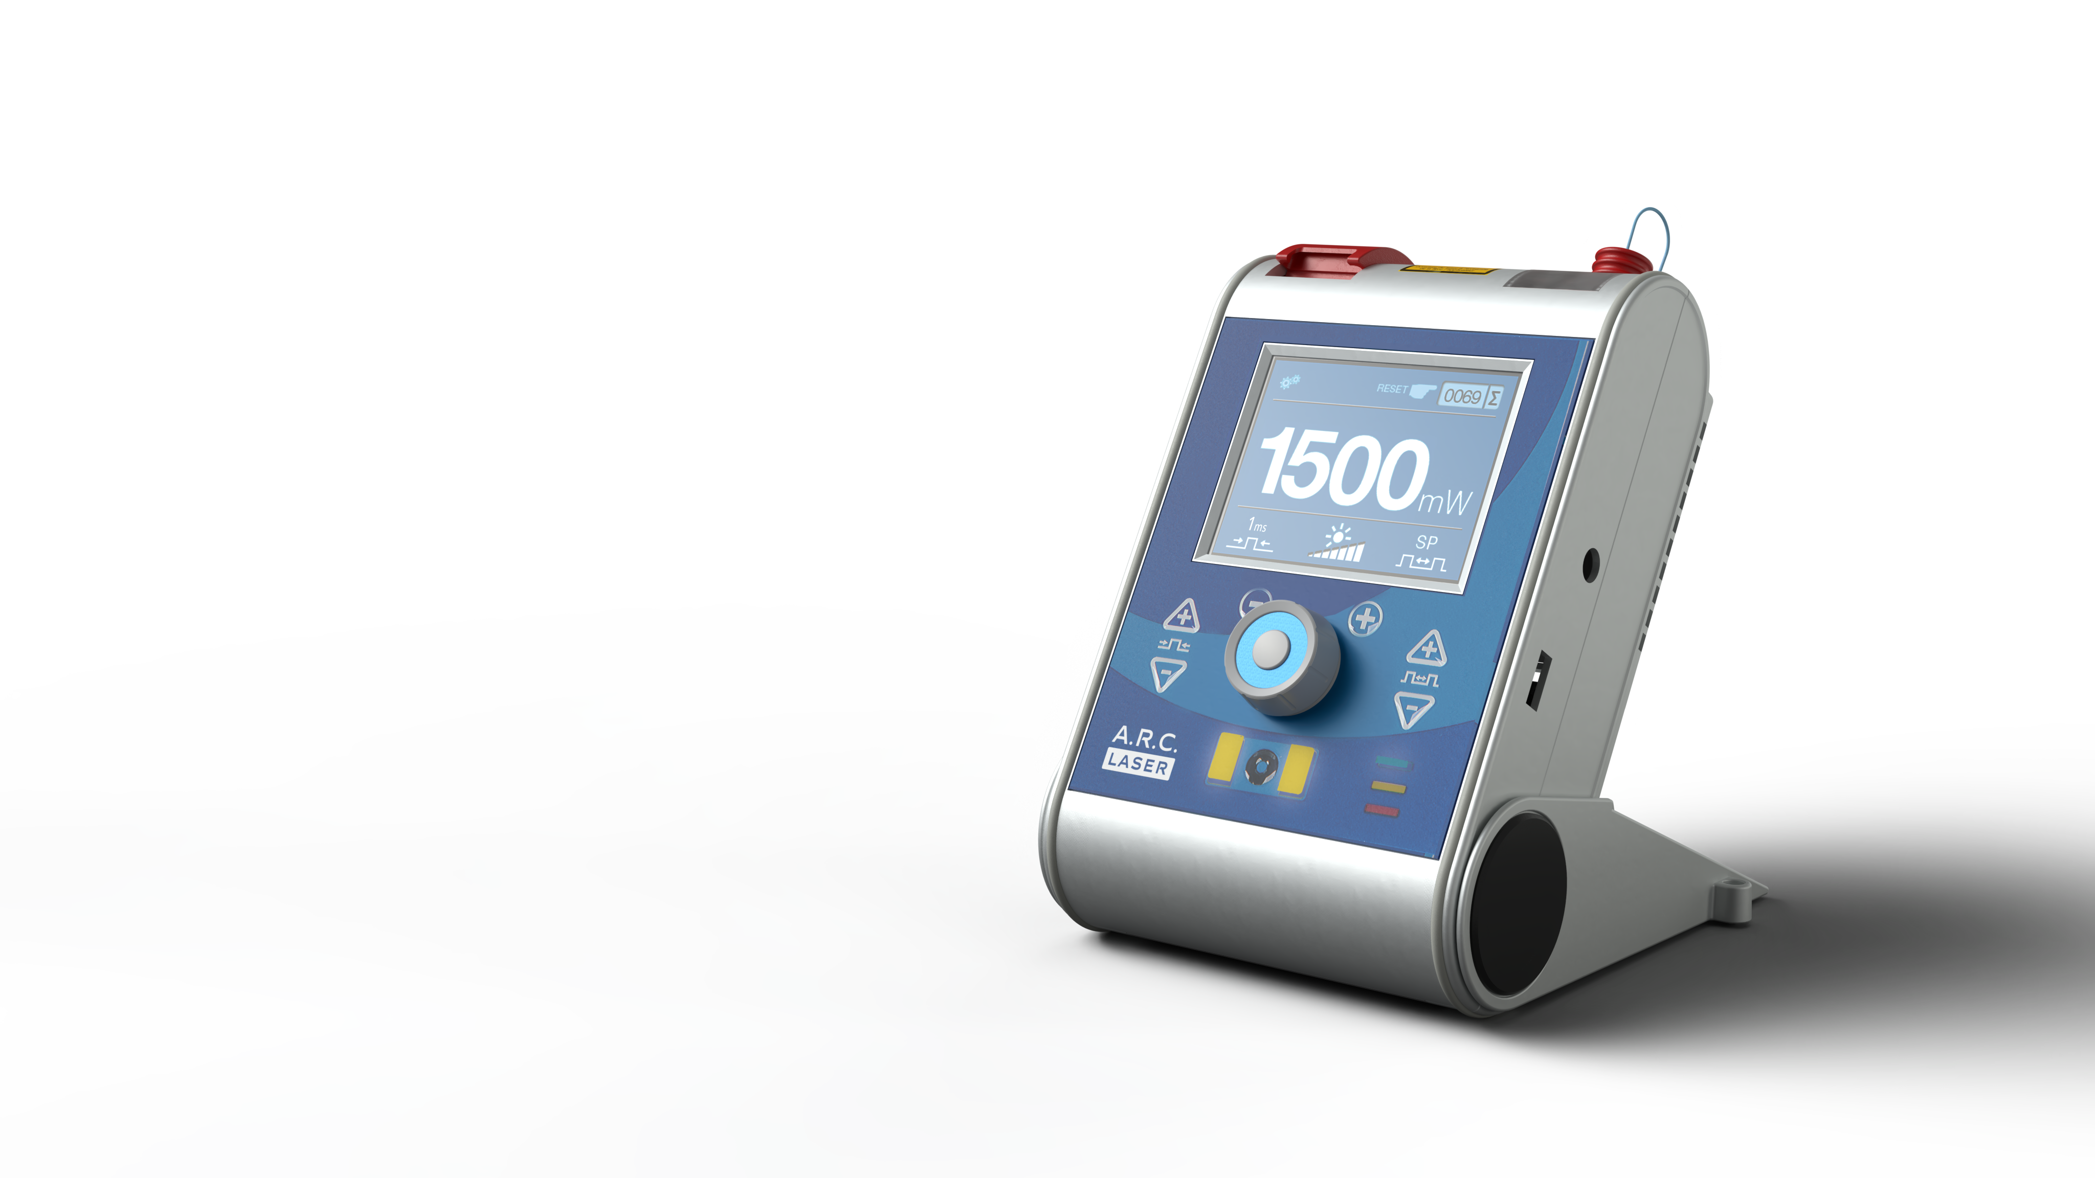
Sales Training – Portfolio Ophthalmology
A.R.C. Laser - ArgonGreen Technology Line
  Classic 514
  Retina laser
    Retina coagulation
    Retina therapy
  FOX 514
  Endo Laser
  Retina coagulation by use of
  Endo Probes and
  LIO
Retina coagulation
Retina therapy

Slide 16
Sales Training – Portfolio Ophthalmology
A.R.C. Laser - ArgonGreen Technology Line
  Classic 514 and FOX 514
  USPs
  The one and only lasers in ophthalmology offering the original argon wavelength
  Soft and homogeneous coagulation effects without hotspots
  Reduced pain sensation for improved patient comfort
Retina coagulation
Retina therapy

Slide 17
Sales Training – Portfolio Ophthalmology
A.R.C. Laser – ArgonGreen Technology Line
  Classic 514 and FOX 514
  Competitors
  Ellex – Lumibird – Australia
  Iridex – USA
  Lightmed – Taiwan
  Lumenis - Israel
  Meridian – Switzerland
  Nidek – Japan
  Norlase – Denmark
  Omesis Medikal - Turkey
  Quantel – Lumibird – France
  Zeiss – Germany
Retina coagulation
Retina therapy

Slide 18
Sales Training – Portfolio Ophthalmology
A.R.C. Laser – ArgonGreen Technology Line
  Classic 514 and FOX 514
  Competitors
  Ellex – Lumibird – Australia
  Iridex – USA
  Lightmed – Taiwan
  Lumenis - Israel
  Meridian – Switzerland
  Nidek – Japan
  Norlase – Denmark
  Omesis Medikal - Turkey
  Quantel – Lumibird – France
  Zeiss – Germany
Retina coagulation
Retina therapy

Slide 19

Sales Training – Portfolio Ophthalmology
A.R.C. Laser – Academy
  academy.arclaser.com
  Clinical Webinars: Live and on-demand
  Academy live @ congresses: Booth activities like
  Booth Talks or Meet-the-Expert sessions
  Scientific Topics: A.R.C. Laser Technologies
  Fundamentals Research

Slide 20
Sales Training – Portfolio Ophthalmology
A.R.C. Laser – Online call to actions & landing pages
  Landing pages:
  microcpc.arclaser.com → linked in section Glaucoma & FOX IV 810
  nanolaser.de → patient orientated information → linked in section Cataract & NanoLaser CETUS
  CTAs:
  TCL-DCR
  https://www.arclaser.com/portfolio/ophthalmology/lacrimal-surgery
  Contact form → access to literature map & operation video
  NanoLaser Cataract Surgery:
  https://www.arclaser.com/portfolio/ophthalmology/cataract/information-for-medical-professionals-formular
  Contact form → access to detailed product information focused on cataract surgeons
  A.R.C. Academy
  → Contact forms for on-demand request

Slide 21
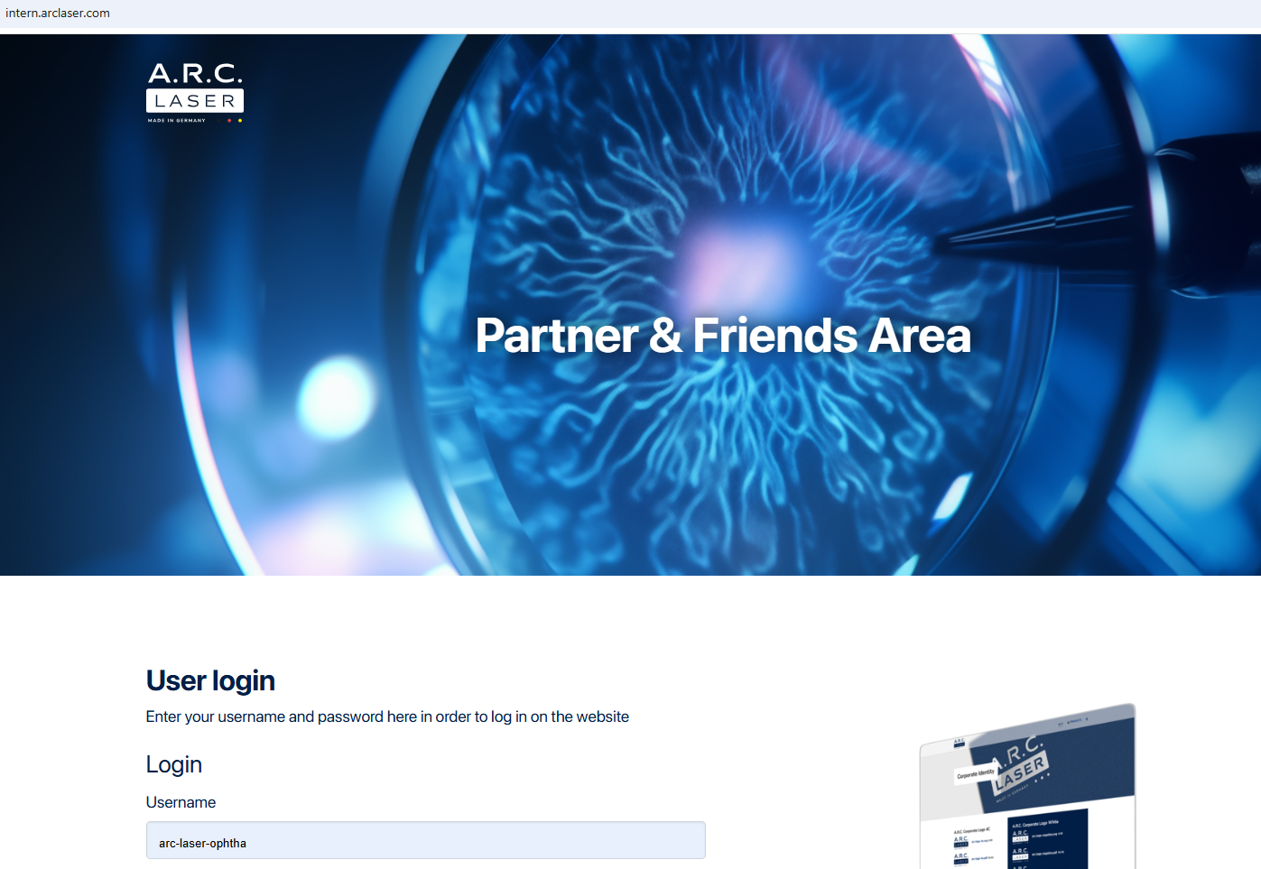
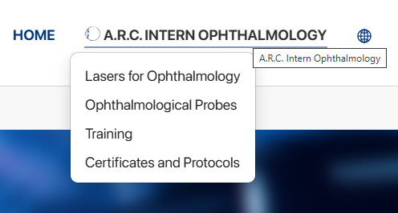
Sales Training – Portfolio Ophthalmology
A.R.C. Laser – sales training material and Downloads
  Intern.arclaser.com

Slide 22
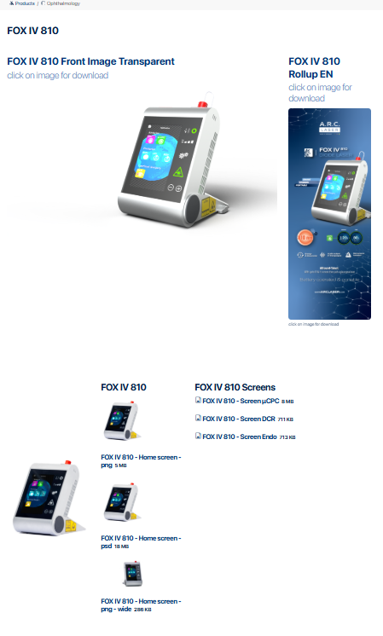
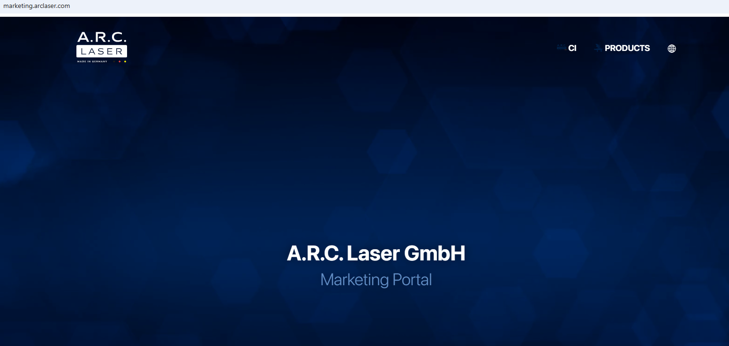
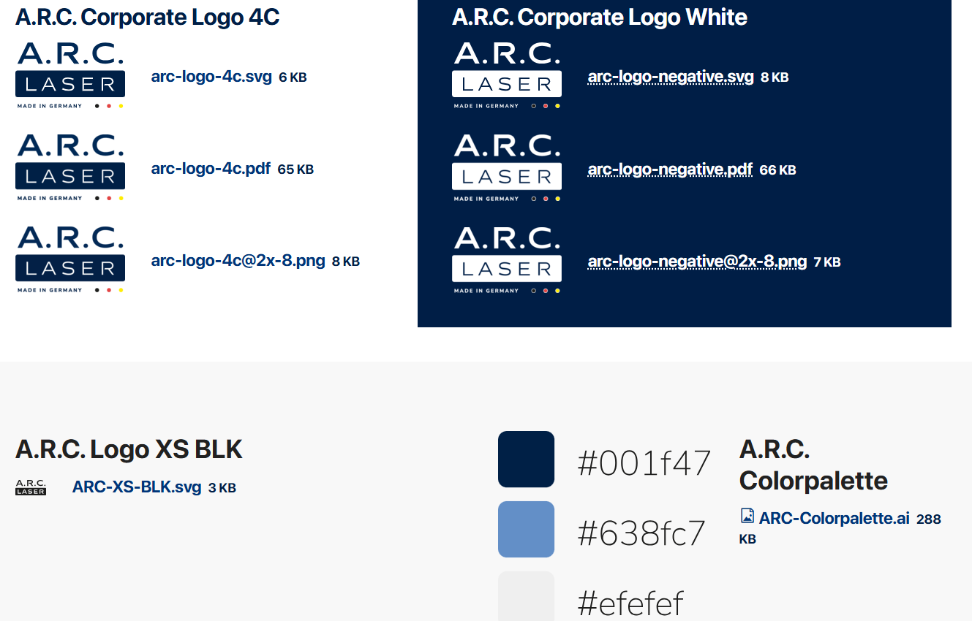
Sales Training – Portfolio Ophthalmology
A.R.C. Laser – marketing related content - files
  marketing.arclaser.com

